Slide 1
Preparing Papers for Successful Publication

Slide 2
Overview
Why publish?
Writing up your research
Choosing a journal
Submitting your paper
The editorial process and peer review
Ethics!
Promoting your work

Slide 3
Why publish your research?
Academic journals are the “bread and butter of research” – certainly in the natural sciences
Making your results available to the scientific community
To build on the existing academic literature
Career advancement/notoriety - “Publish or Perish”
Getting in before the competition!
Communication with peers
Validation

Slide 4
Study design & ethical approval
Good research should be well justified, well planned, appropriately designed, and ethically approved (COPE: Guidelines on good publication practice)
Research should answer specific questions, not just collect data
Protocols / methods should be agreed by all contributors
Consider statistical issues early in study design. Ensure adequate power and appropriate numbers of experimental units / participants
Formal and documented ethical approval must be obtained from an appropriately constituted research ethics committee
Research involving humans or animals will usually require a licence and full compliance with local and national regulations

Slide 5
Analysis & presentation of data
Ensure your data are appropriately analysed
Fully declare and describe sources and methods used to obtain and analyse data
Inappropriately analysed data may result in misleading or false interpretation – if deliberate this is falsification of results
Exclusions or omissions from the data should be fully disclosed and explanations provided
Any issues of bias should be discussed, including how they have been dealt with in the design and interpretation
Manipulation of images should be declared and explained
Use of previously published data and/or illustrations must be declared, the source/s acknowledged, and permissions obtained

Slide 6
Authorship
All authors should have contributed to the paper
Contributions include conception, design, data collection, analysis, writing
Authors take responsibility for the content of the paper
All authors must be able to competently describe the paper in detail
Avoid conflicts by deciding early who will be credited with authorship
Conflicts of interest (financial, commercial, political, personal) – potential or real – should be declared to all authors and the editor
Similar or related publications from all authors should be declared to all authors and the editor
INTERNATIONAL COMMITTEE OF MEDICAL JOURNAL EDITORS has a great section on authorship, defining the role of an author etc.

Slide 7
Writing a paper – key points
Strong introduction
What is the story you are going to tell?
Methods
Clear, logically organised, complete
Could someone else repeat the study?
Results
Clear, logically organised, complete
In the most appropriate format (text, tables, or figures)
Discussion
Relevant to hypothesis or study aims
Emphasis on significance and implications
In context of existing literature

Slide 8
So much data – so little space
A journal does not want your notebook or your thesis!
The compulsion to include everything, leaving nothing out, does not prove that one has unlimited information; it proves that one lacks discrimination. S. Aaronson (1977)
The fool collects facts; the wise man selects them. J. W. Powell (1888)
Be concise – short and to the point is most effective

Slide 9
Attracting readers
Your paper is competing with many others for the attention of editors, referees, and readers
Title
Brief, interesting, accurate
Should be engaging, accurate and appropriate
Abstract
Attract readers to your paper
Aim for four sections: why, how, what, and implications
Include important keywords for searching
Make it clear, make it easy to read

Slide 10
1. How Diversity Works
2. United States Health Care Reform: Progress to Date and
Next Steps
3. The irreversible momentum of clean energy
4. Overview of active cesium contamination of freshwater fish in Fukushima and Eastern Japan
5. Experimental evidence of massive-scale emotional contagion through social networks
6. The next wave of deaths from Ebola ? the impact of health care worker mortality
7. Why Most Published Research Findings Are False
8. When Facts Backfire
9. Medical error—the third leading cause of death in the US
10. What Are the Potential Effects of the Graham-Cassidy ACA Repeal-and-Replace Bill? Past Estimates Provide Some Clues
Honourable mention: Simulations back up theory that Universe is a hologram

Slide 11
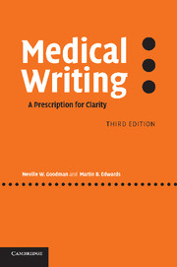
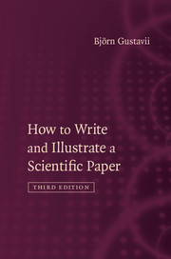

Slide 12
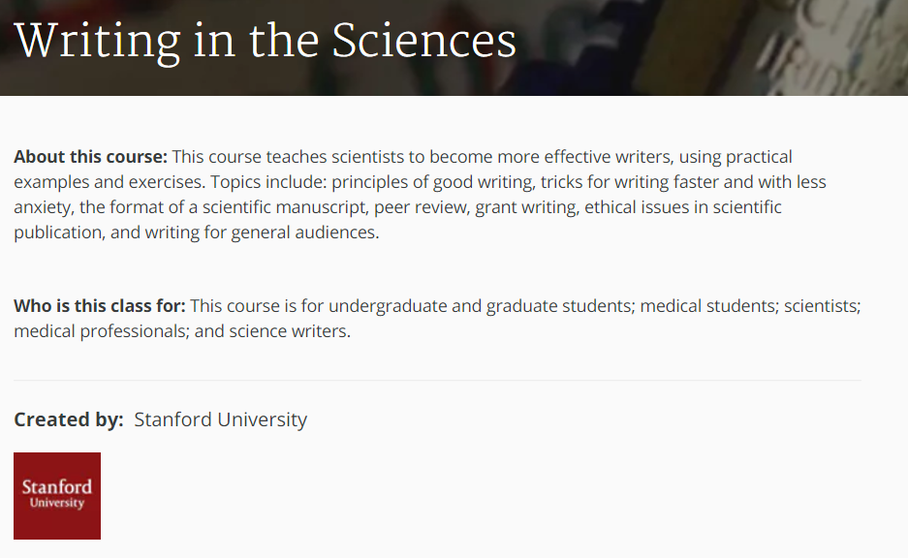
Free Courses in Scientific Writing
https://www.coursera.org/learn/sciwrite/#

Slide 13
Where to Publish Your Research?
Ask for expert advice – your academic advisor or your peers
Each field will have its own specialist journals
Chances of getting rejected from the most sought after journals is higher
Choose a journal which suits the tone of your work
Don’t let your paper drift around the journalsphere for too long!

Slide 14
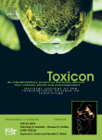
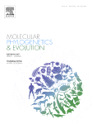
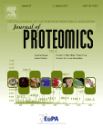
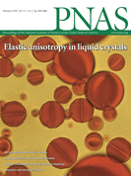
“A central role for venom in predation by Varanus
komodoensis (Komodo Dragon) and the extinct giant
Varanus (Megalania) priscus)”
“Venom on ice: First insights into Antarctic octopus venoms”
“Venom proteomic characterization and relative
antivenom neutralization of two medically
important Pakistani elapid snakes (Bungarus
sindanus and Naja naja)”
Notes:
Just a quick example of what I have just spoken about. Here we have 3 papers published by one researcher in the course of his career. One has gone into a very specific journal very specialised for his field (Toxicon), another has gone into one of the middle journals with a broader scope – in this case journal of proteomics but I have also added a few other examples here. In this instance perhaps he thought that the work did not fulfil the aims of the very specialised journal or perhaps he genuinely wanted to reach a larger target audience of protein scientists with his paper.
The third paper presented some very groundbreaking research in the field which would be of interest to the general scientific community and as such, has been published in PNAS. So just a real life example here to illustate the diversity of journals which one researcher may consider over their career.

Slide 15
Submitting
Make sure you have clearly read the “Instructions for Contributors”
Correct formatting for that particular journal: length, style, format, type of file, and how to submit
Make sure your article is the best that it can be!
Make sure that you have secured the necessary permissions for material used in the article – quotes, pictures etc.

Slide 17
Journal Publishing Process
Reject
More revision
Submission
Refereeing
Revision
Acceptance
Publication
Reject
Reject
Reject

Slide 18
Before you submit your paper
Internal review
Ask your peers to read it, to get an alternative perspective
Ask someone outside your field to read it
Write a covering letter to the editor
Should clearly explain (but not overstate) the research
Should explain why you have chosen this journal
Submit with the consent of all authors and to only one journal
Duplicate submission wastes everyone’s time
If detected, it will likely lead to rejection by all journals

Slide 19
What happens once you have submitted?
Acknowledgement of receipt
Editorial review
Sent for peer review
What are the drivers & motivations for the Editor?
Publishing new, interesting, and important research
Improving the profile and impact of their journal
Providing content the subscribers want to read (and pay for)
Publishing papers that will attract new authors and readers

Slide 20
What is the Editor seeking?
Quality!
Good research: well planned & well executed study
Good presentation
Novelty, significance, originality
Consistency with scope and direction of journal
Demonstrated broad interest to readership
Will it cite?
Interesting, well written ‘story’
Clarity and honesty

Slide 21
Editorial ethical issues
Editors are responsible for everything published in their journals.
They must ensure:
Integrity of the academic record
Fair, objective assessment of all submissions
Identities protected as appropriate
Unpublished work remains confidential while in review
All research conforms to accepted ethical guidelines; appropriate permits obtained
Business needs do not compromise intellectual standards or freedom of expression
It’s worth having a look at Retraction Watch (link in the references section)

Slide 22
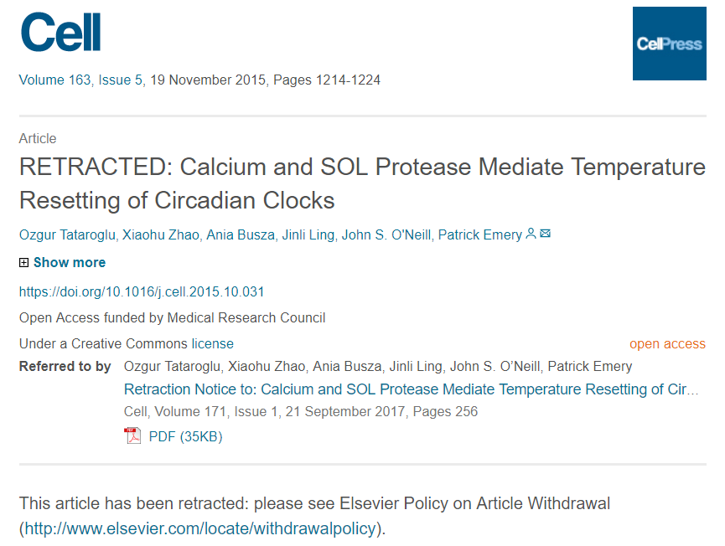
Retraction Watch

Slide 23
Peer-review ethical issues 1
Reviewers must be appropriate and able to comment usefully
Editors should respect requests from authors not to use a particular reviewer, if these are well reasoned
Reviewers must declare any possible conflict of interest to the Editor
competing unpublished results, personal disagreements, previous review of the same paper, involvement with the work, close association with the author(s), financial dealings
Reviewers have a duty of confidentiality during assessment
Should seek the Editor’s permission to obtain additional advice from colleagues
May not use data, arguments or interpretations without the authors’ consent

Slide 24
Referee reports One paper, two perspectives

Slide 25
Referee reports One paper, two perspectives
What does the author see?

Slide 26
Referee reports One paper, two perspectives
What does the author see?
What does the editor see?

Slide 27
Responding to referee reports
Read the editor’s letter first for instruction
Take a deep breath
Read the reports
Put them aside for a day to a week
Re-read the reports, discuss with co-workers
Revise the paper and prepare a response document
Even comments that seem aggressive or ignorant can be helpful
Always view this as a chance to improve the paper

Slide 28
Getting a positive decision
If you’ve been asked to revise the paper, the Editor thinks you have something worth publishing
The Editor will make a final decision based on how well the referees’ reports have been addressed, so
Revise with care
Respond fully to each of the referees’ comments
Present cogent and complete arguments if you have not followed a referee’s recommendation
Once your article is published, celebrate! ☺ The next day, update your resume / C.V.
Make the Editor’s job as easy as possible

Slide 29
Concluding remarks
Writing for successful publication means
having a well designed, original study to write about
knowing what you want to write and why
understanding who you are writing for
writing clearly and honestly
making the story interesting
highlighting the significance of the results
responding carefully and positively to referees’ reports

Slide 30
Useful Links Committee on Publication Ethics www.publicationethics.org International Committee of Medical Journal Editors http://www.icmje.org/ Retraction Watch http://retractionwatch.com/

