Slide 1
OECD iLibrary
Data and Analysis for Economics & Social Sciences
Damon Allen

Slide 2
Overview
What is the OECD?
OECD iLibrary
  Data
  Analysis
How is this useful?

Slide 3
What is the OECD?
International organisation
Advises governments about economy, society & environment
Publishes data & analysis

Slide 4
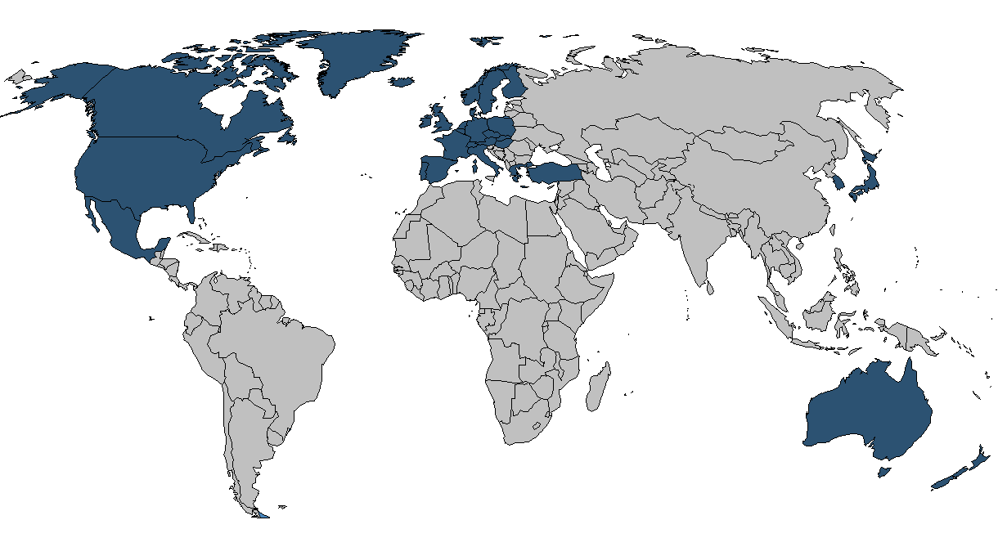
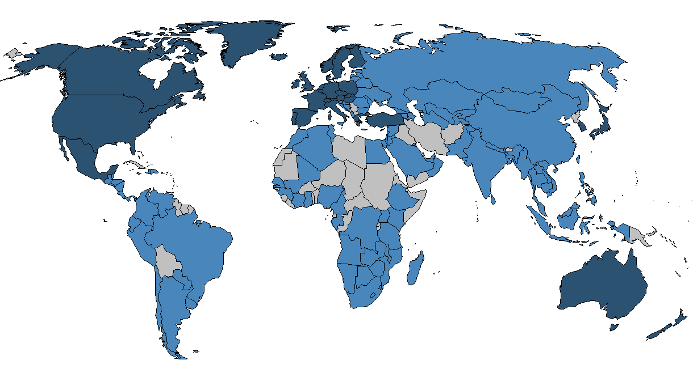
Global reach
OECD member countries
OECD partner countries

Slide 5
Global comparison
Data from all over the world
Compare countries‘ performance
What can we learn from other countries?

Slide 6
Topic: Economy
Economy:
  Country Surveys (OECD Economic Surveys)
  Prognoses (OECD Economic Outlook)
  Themes:
    R & D, Innovation
    Business, industry and services
    Trade
    Finance, investment
    Governance

Slide 7
Topic: Society
Social issues:
  Employment
  Education
  Health
  Migration
  Quality of Life

Slide 8
Topic: Energy & Environment
Energy & Environment:
  Energy prognoses (International Energy Agency)
  Sustainablity
  Environmental policies

Slide 9
Online resources
Homepage:
www.oecd.org
Online library:
www.OECD-iLibrary.org

Slide 10
OECD iLibrary
Data:
  300 Databases with 5,000,000,000 datapoints
  50,000 Excel tables
Books/Journals:
  9,000 E-books
  35 Journals
  4,000 Working papers

Slide 11
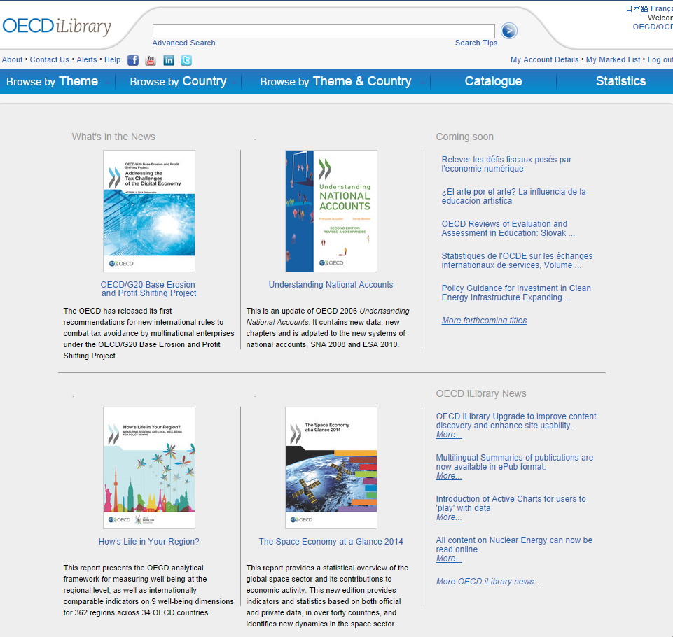
www.oecd-ilibrary.org

Slide 12
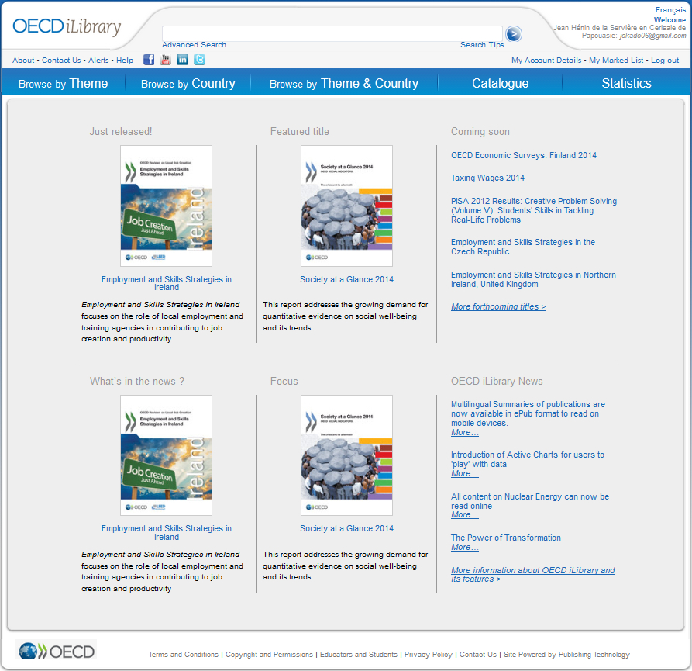
Navigation
Quick access
Theme +
Country
Books,
Papers
Statistics

Slide 13
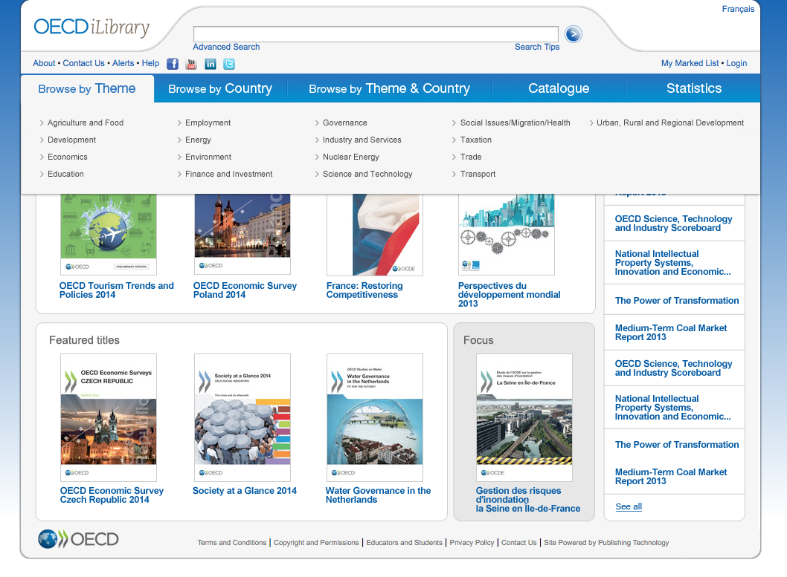
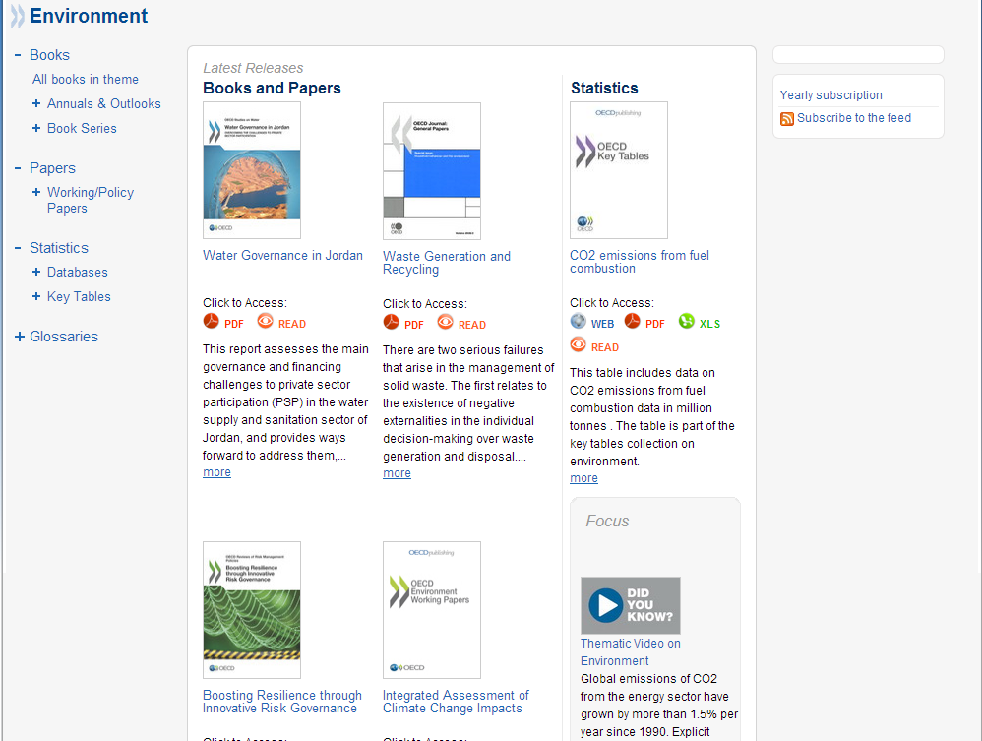
Browse by theme
17 theme homepages
Books (PDF, ePub, Read)
Papers (PDF, ePub, Read)
Statistics (XLS, Data)

Slide 14
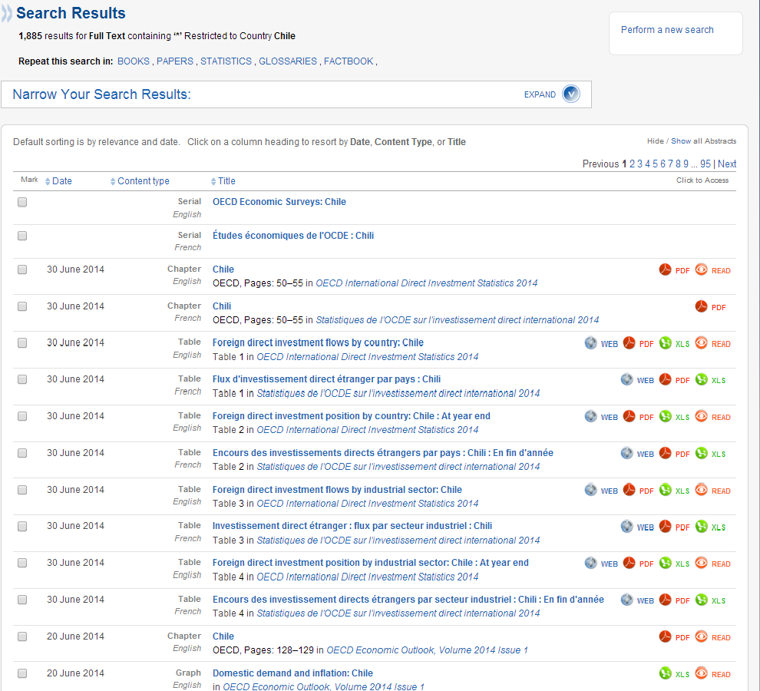
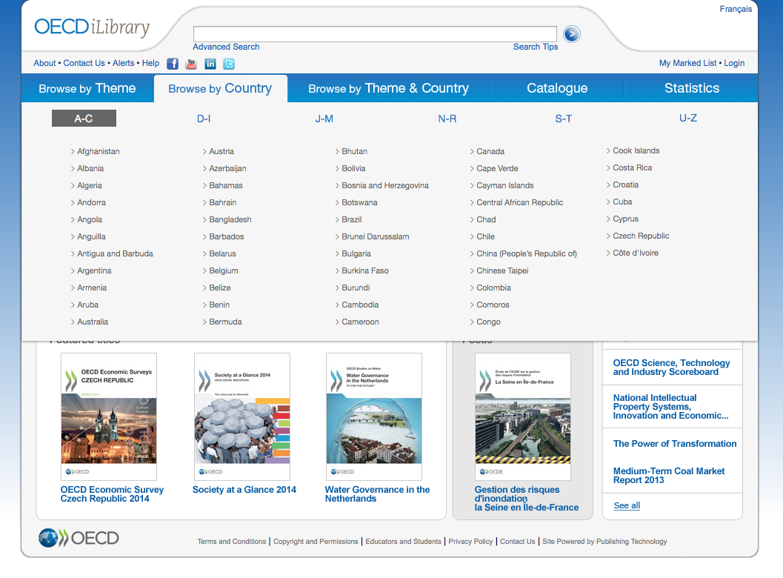
Browse by country
Fast access to country information
Content broken down into parts

Slide 15
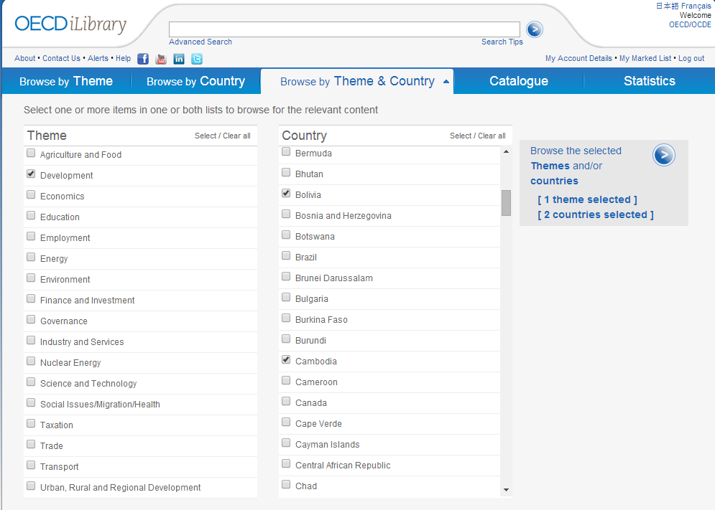
Theme + country
Combine multiple
Themes
+
Countries

Slide 16
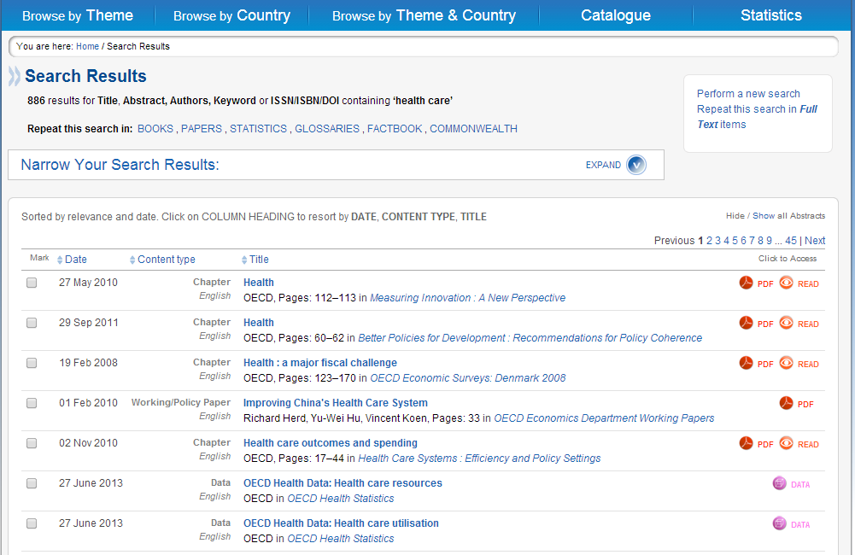
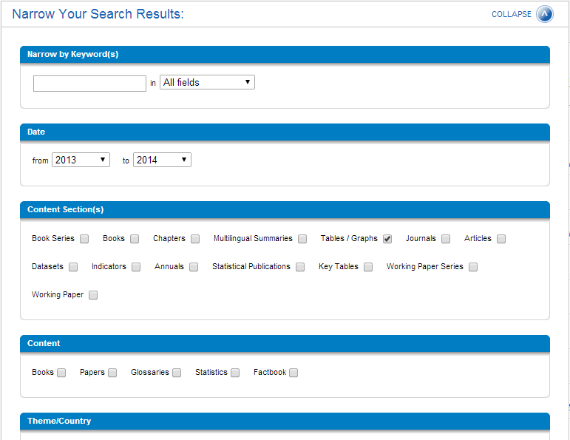
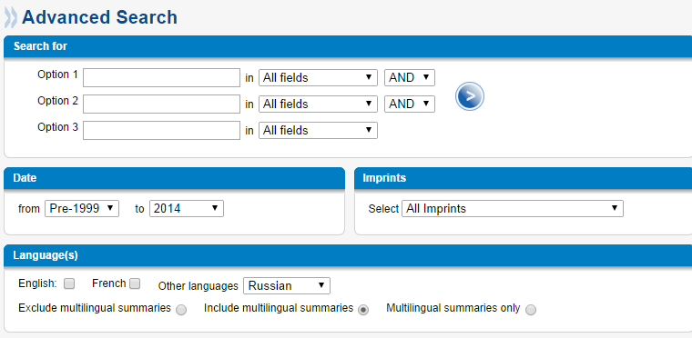
Advanced search
Narrow search results
Filter by
Date
Content type
Language
etc.

Slide 17
Statistics
Access to
data

Slide 18
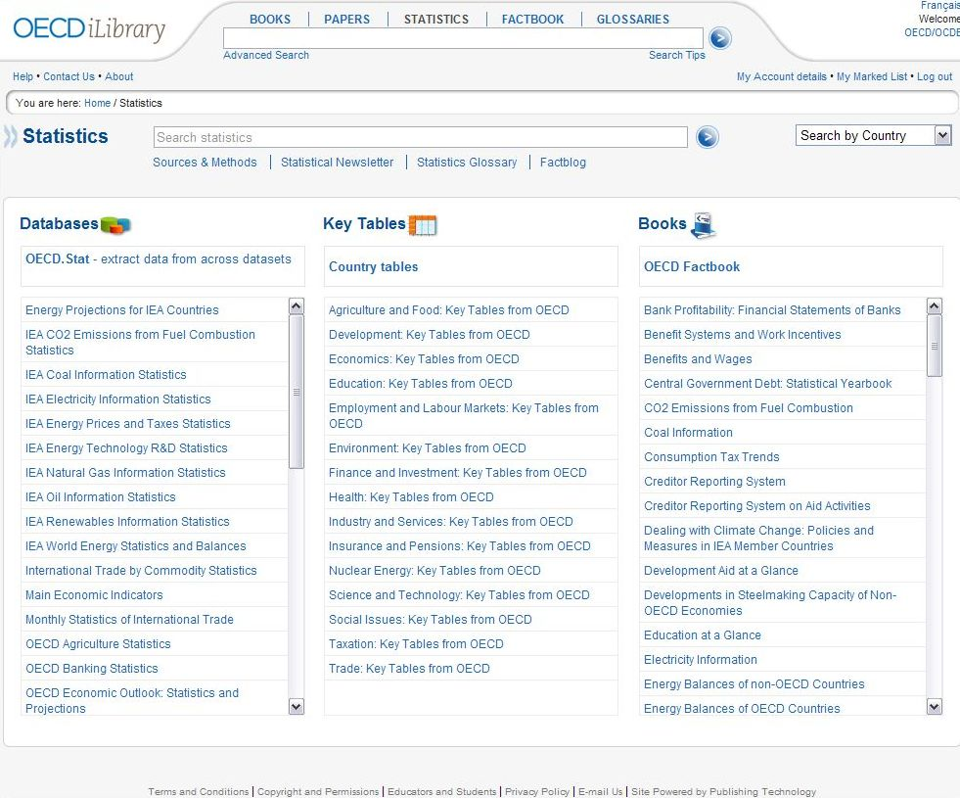
Statistics in three formats

Slide 19
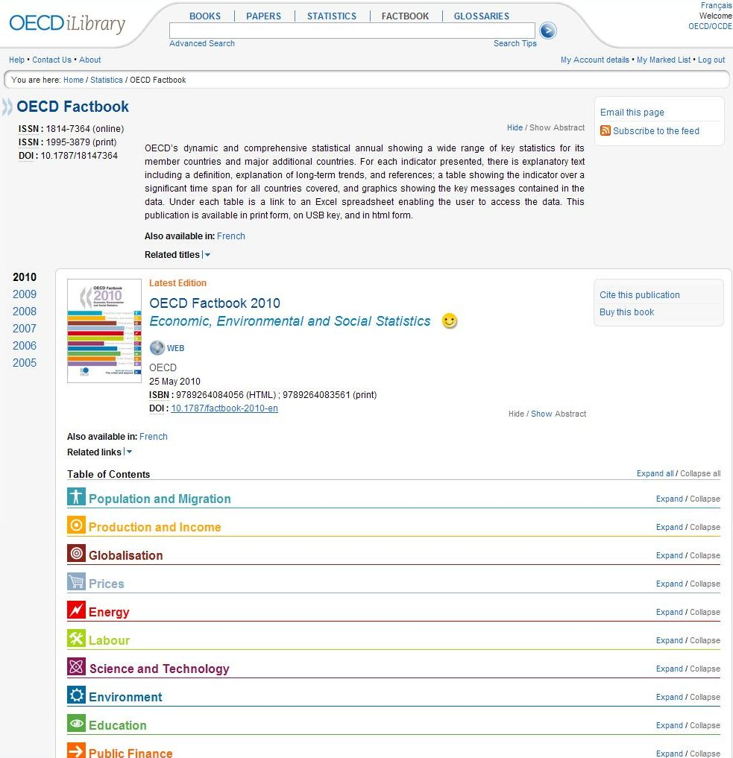
E-Book

Slide 20
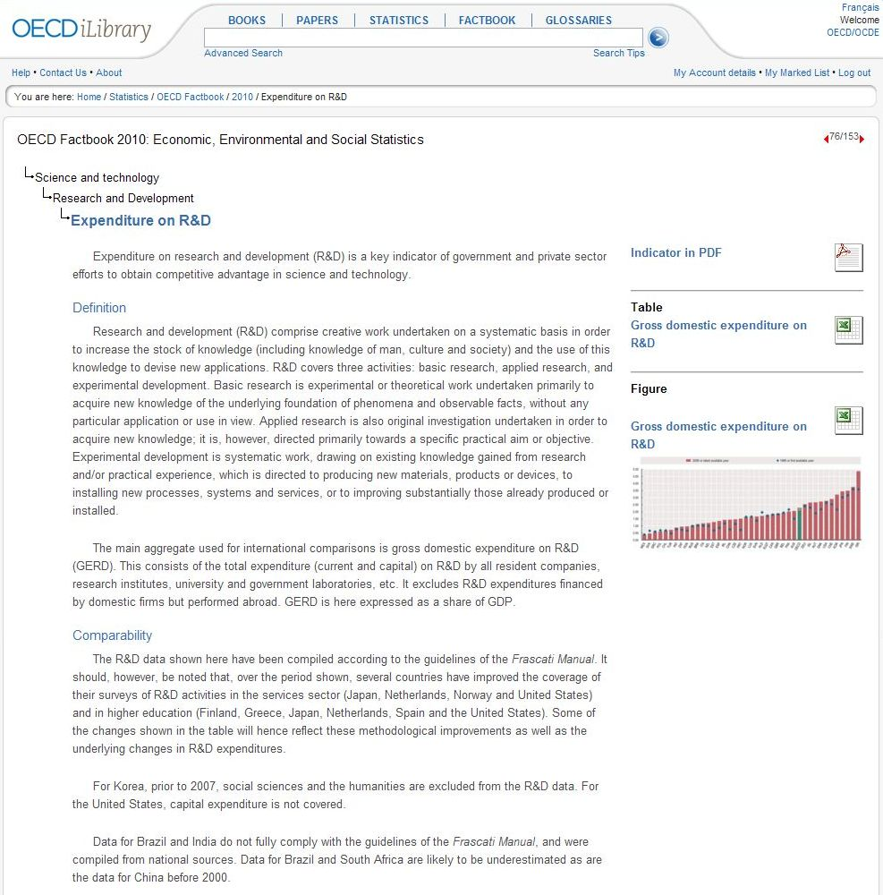
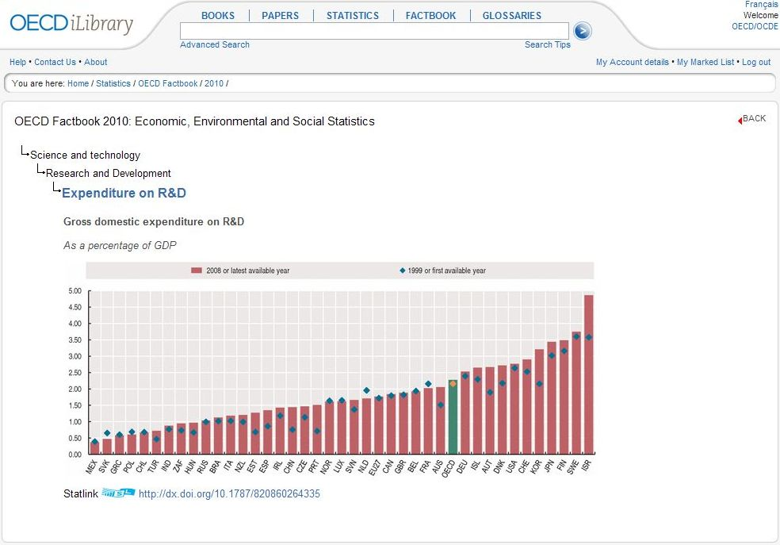
E-Book

Slide 21
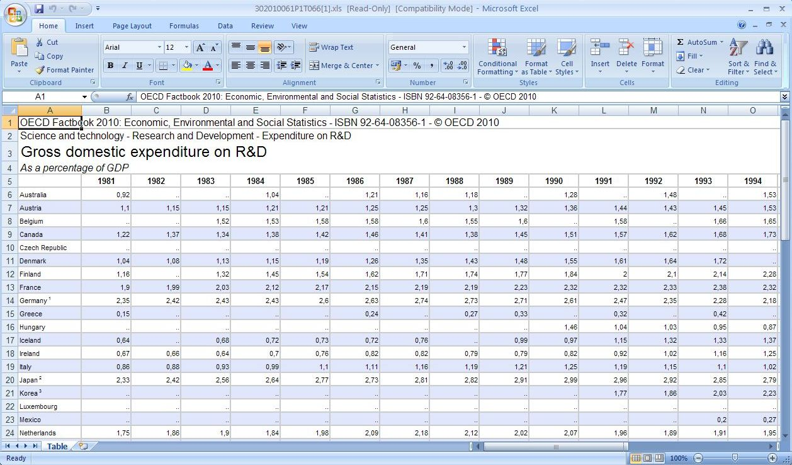
E-Book

Slide 22
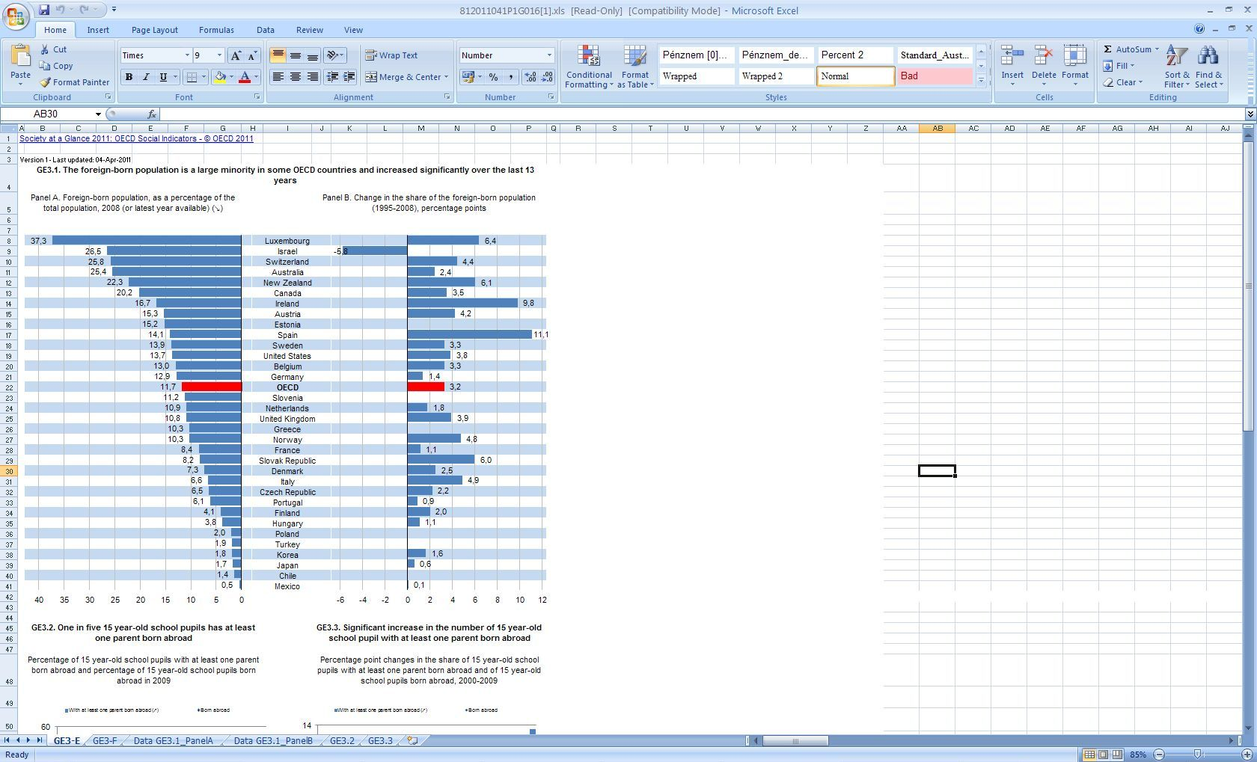
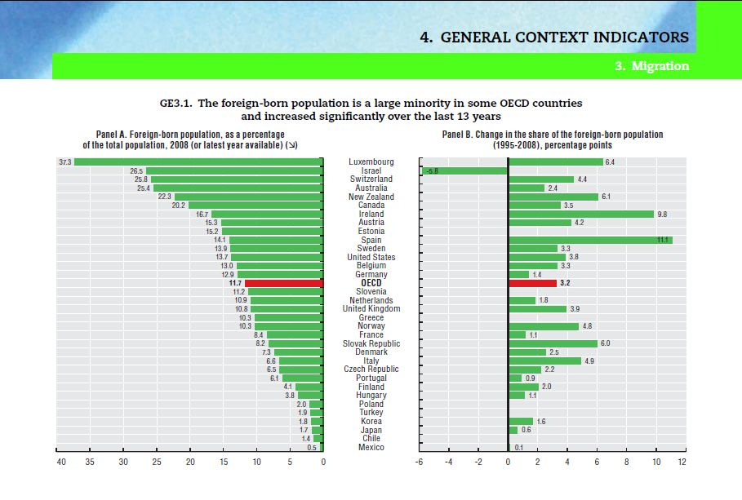
PDF

Slide 23
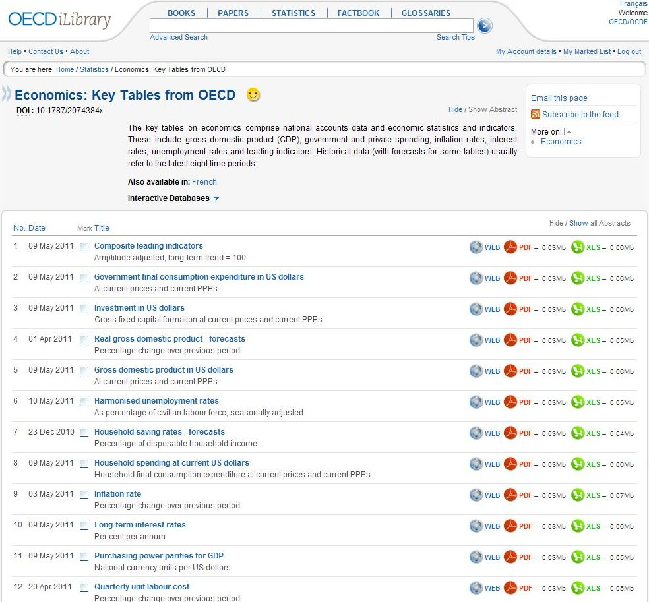
Key tables

Slide 24
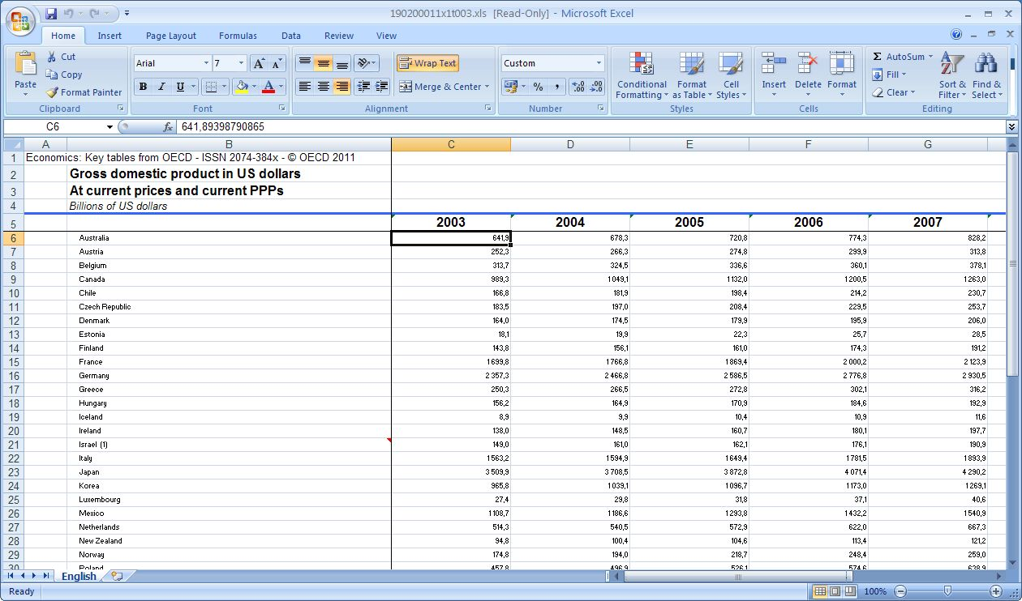
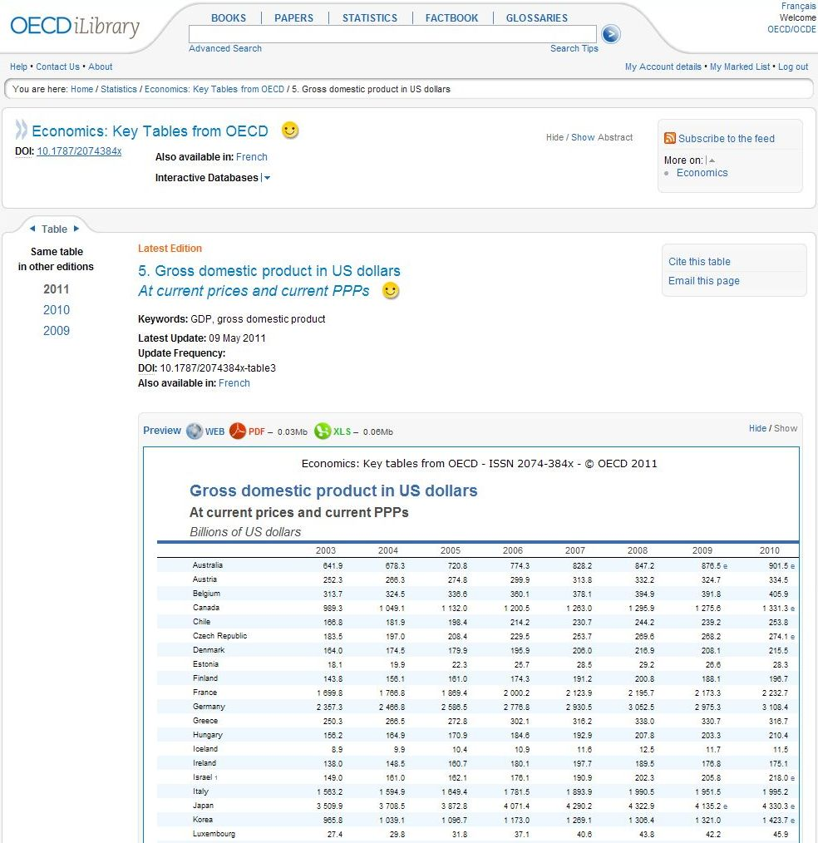
GDP – key table

Slide 25
Databases

Slide 26
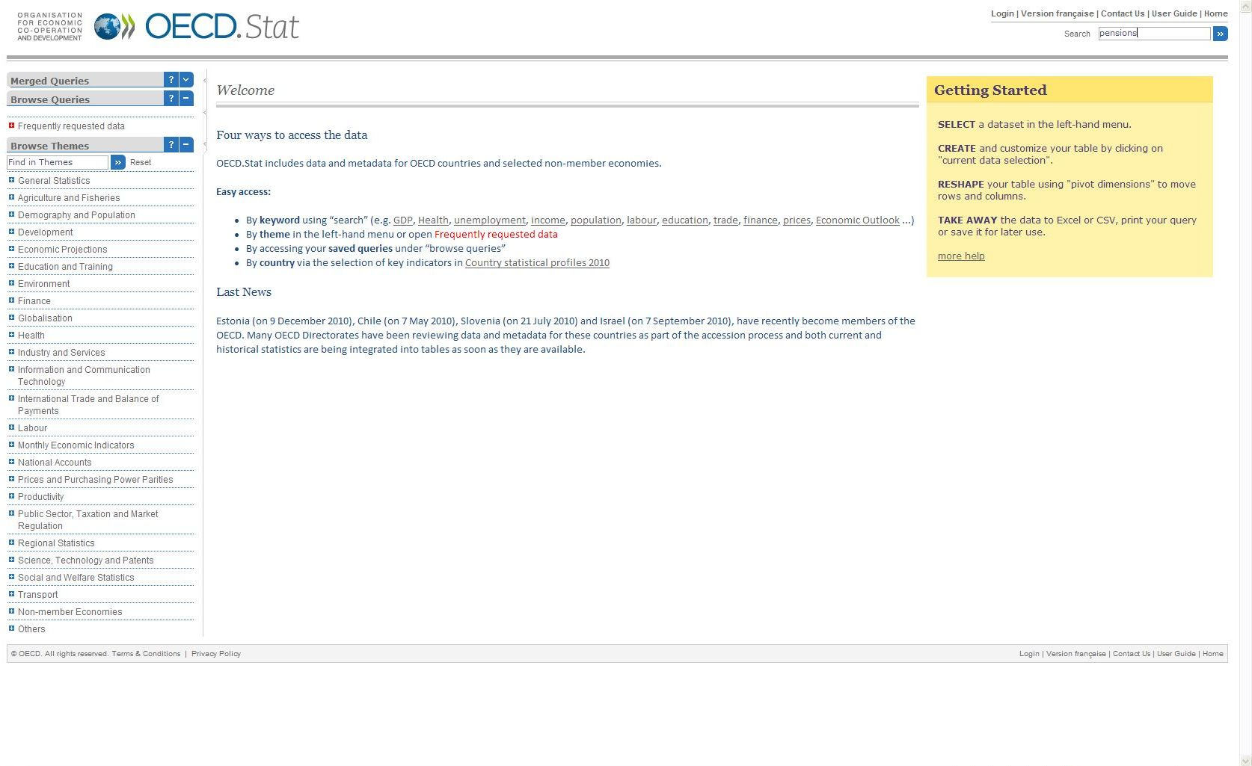
Cross-database search
Full text search

Slide 27
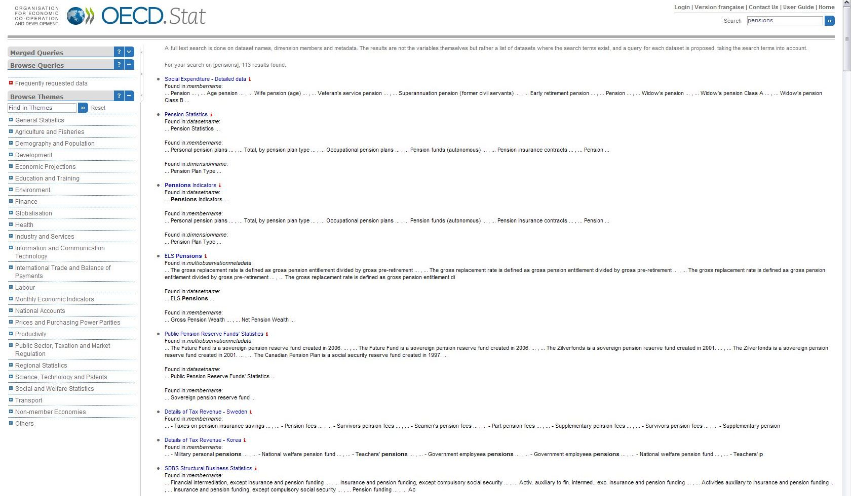
Navigation by theme
Choose theme

Slide 28
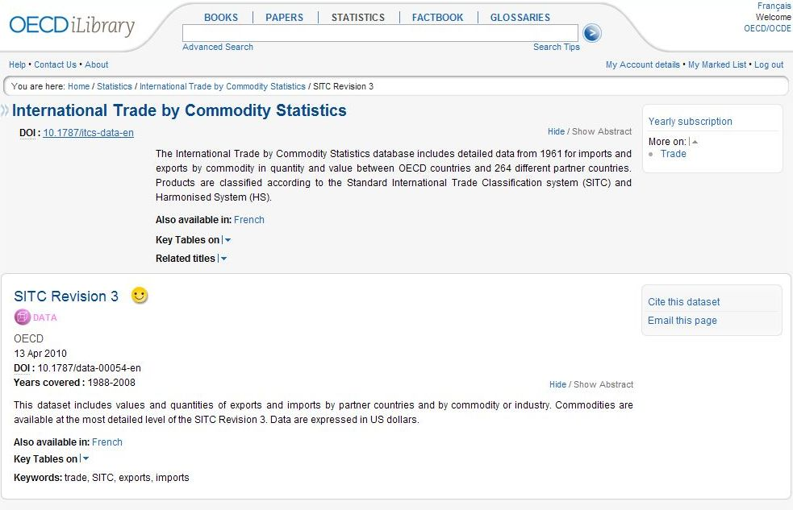
Database homepage

Slide 29
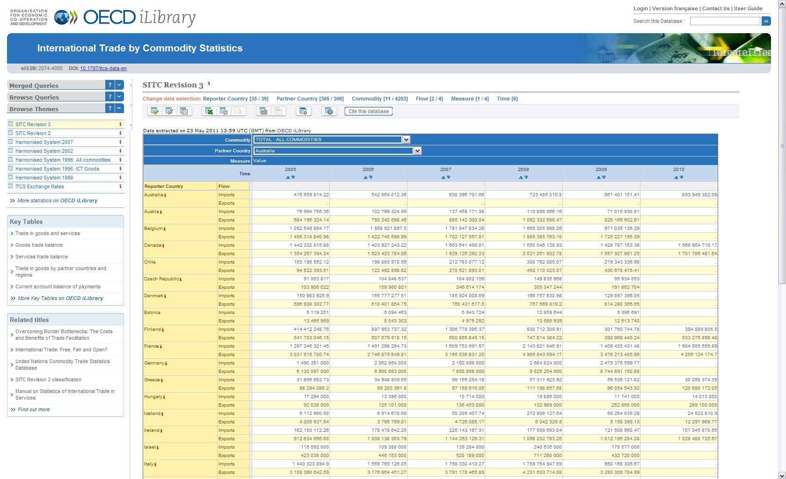
Working with databases
Select data

Slide 30
Working with databases
Functions

Slide 31
OECD databases
Export in different formats

Slide 32
OECD databases
Chart

Slide 33
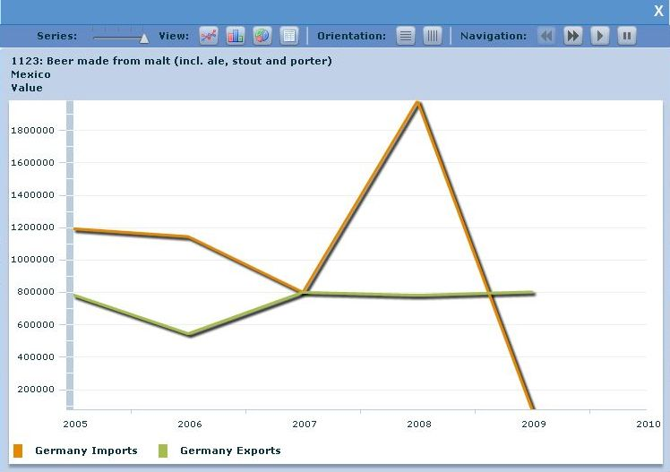
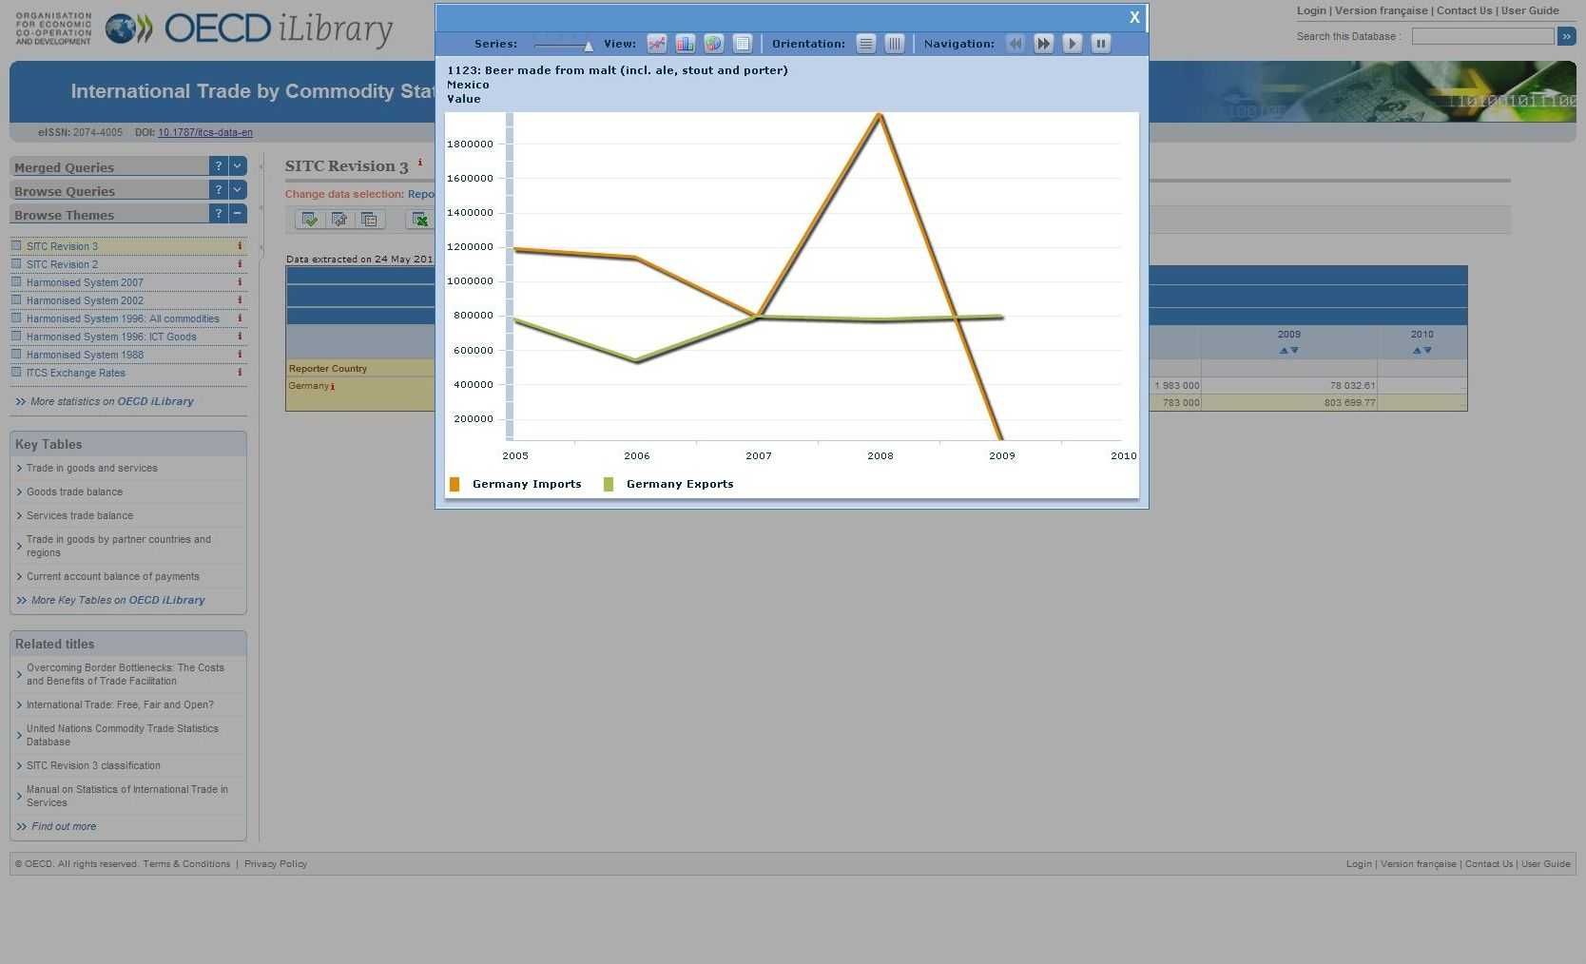
OECD databases

Slide 34
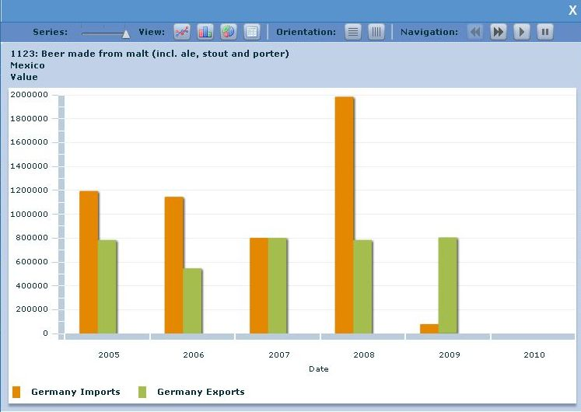
OECD databases

Slide 35
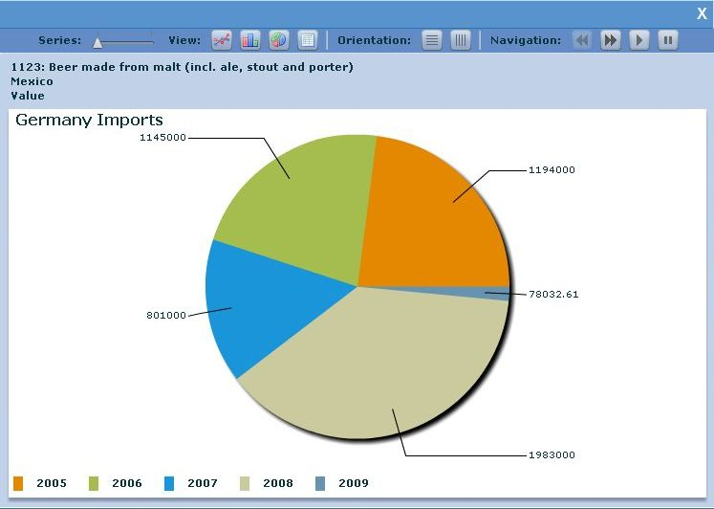
OECD databases

Slide 36
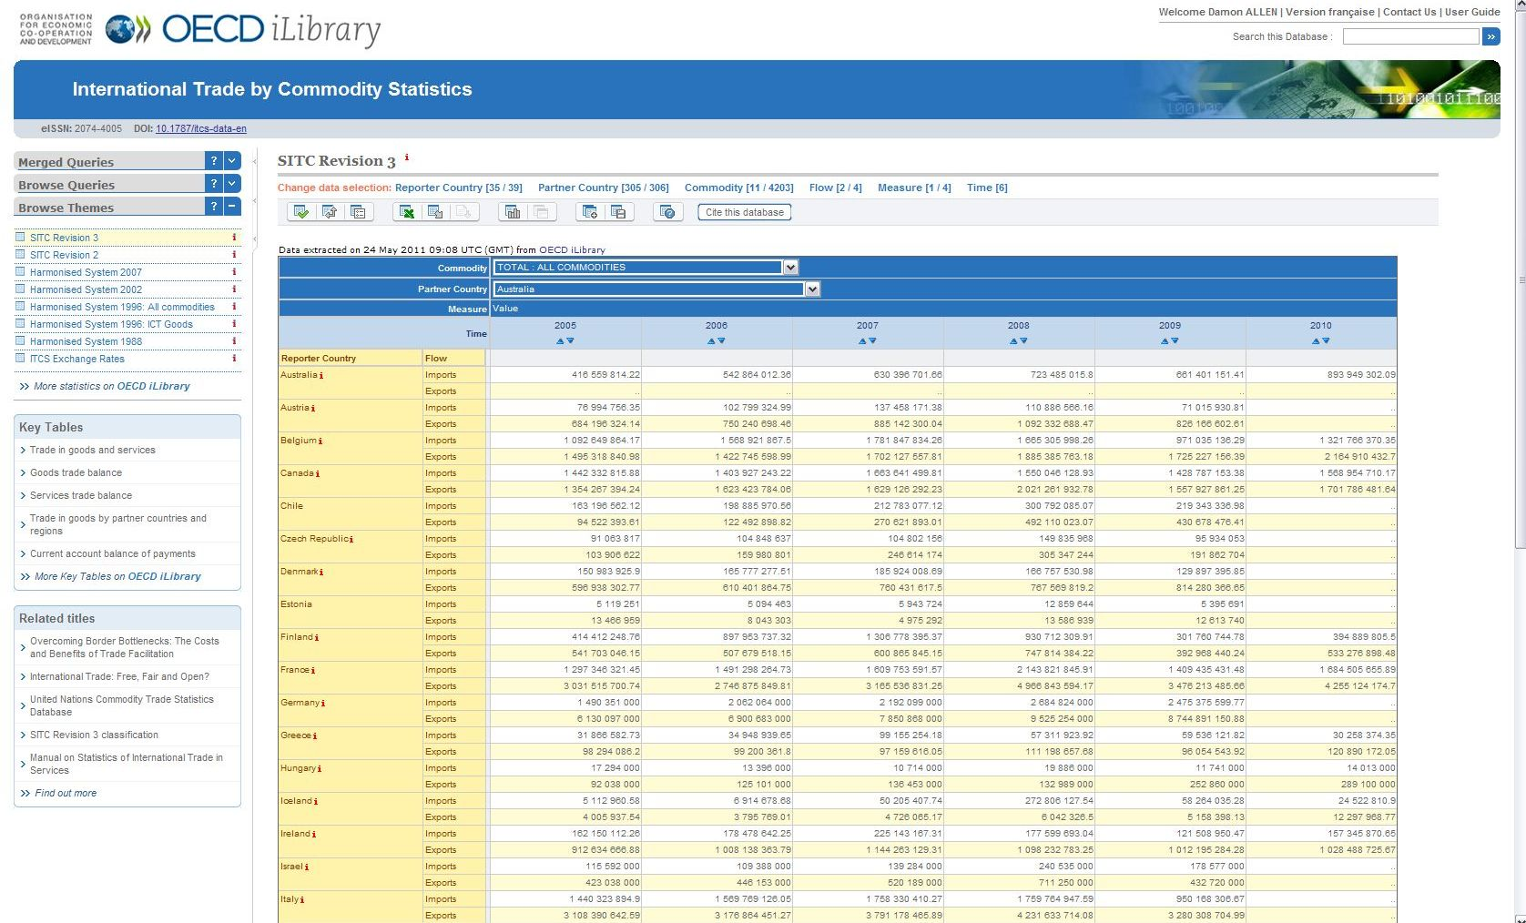
OECD databases
Save table

Slide 37
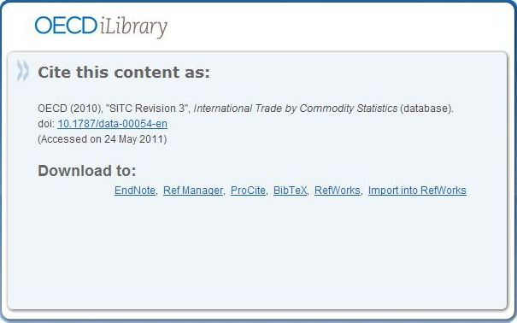
OECD databases
Cite this database

Slide 38
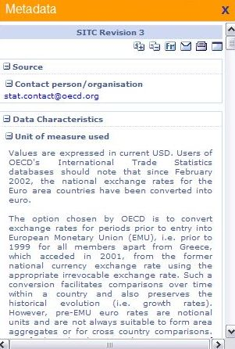
OECD databases
Metadata and further information

Slide 39
OECD databases
Related books

Slide 40
Why is OECD content useful?
Compare countries‘ performance
Identify new economic and social trends
In-depth view of countries and markets
Reliable data for researchers

Slide 41
Features for users
Easy citation
  citation tool
Easy bookmarking & linking
  DOIs
Easy download of charts and tables
  „StatLinks“
Different content for different users
  Databases, indicators, e-books

Slide 42
Features for libraries
COUNTER usage statistics
MARC 21 metadata
  Discovery services (EBSCO, ExLibris Primo, WorldCat, Summon etc.)

Slide 43
Interested?
Free trials
Special pricing
Contact KONEK (info@metecbooks.ru)

Slide 44
Thank you
www.OECD-iLibrary.org
Damon Allen
Sales and Marketing Manager
damon.allen@oecd.org

