Slide 1
Techniques for effective searching with IEEE Xplore
Eszter Lukács
Client Services Manager Europe

Slide 2
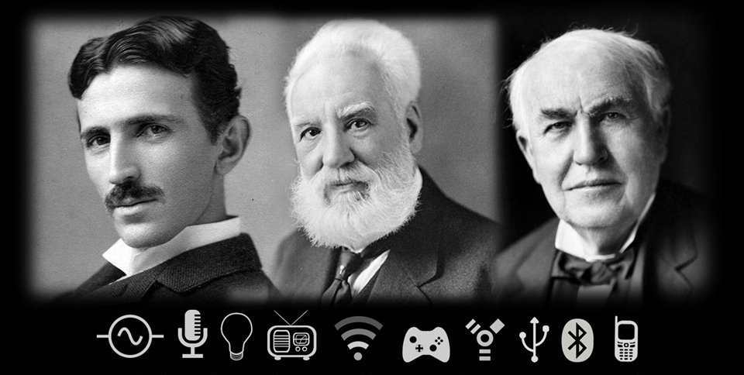
1884: Where we came from
Notes:
A small group of individuals met in New York and founded the AIEE to advance the new field and represent the US at the 1884 International Electrical Exhibition in Philadelphia.

Slide 3
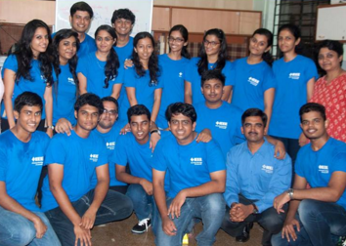
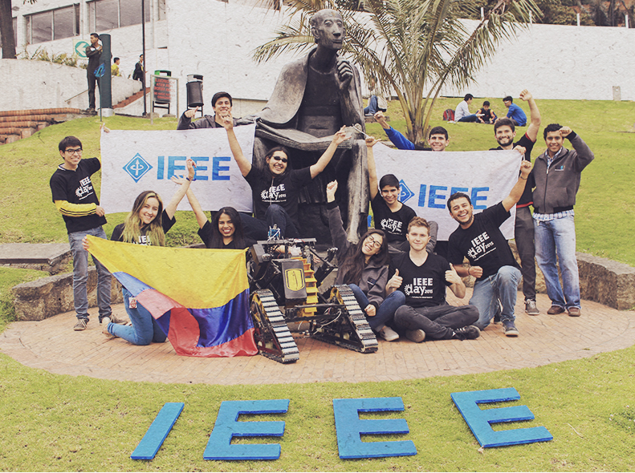
About the IEEE
World’s largest technical membership association with more than 430,000 members in over 160 countries
Not for profit organization “Advancing Technology For Humanity”
Four Core areas of activity
Membership organization
Conferences organizer
Standards developer
Publisher of journals, conferences, standards, ebooks and elearning
IEEE student volunteers in Mumbai
IEEE Xplore by the numbers:
Nearly 4 million total documents
Over 3 million unique users
More than 8 million downloads per month
15 year anniversary in 2015!
IEEE Day Contest Winner, Colombia
Notes:
IEEE Day is a global event to be held on the first Tuesday of October, annually. It celebrates the anniversary of the first time IEEE members gathered to share their technical ideas in 1884. http://www.ieeeday.org
2015 Winner

Slide 4
Why you should rely on
IEEE information

Slide 5
IEEE quality makes an impact
Thomson Reuters Journal Citation Reports® by Impact Factor
IEEE publishes:
17 of the top 20 journals in Electrical and Electronic Engineering
14 of the top 15 journals in Telecommunications
3 of the top 5 journals in Computer Science, Hardware & Architecture
3 of the top 5 journals in Computer Science, Cybernetics
3 of the top 5 journals in Automation & Control Systems
3 of the top 5 journals in Artificial Intelligence
2 of the top 5 journals in Imaging Science & Photographic Technology
The Thomson Reuters Journal Citation Reports presents quantifiable statistical data that provides a systematic, objective way to evaluate the world’s leading journals.
Based on the 2015 study released June 2016
More info: www.ieee.org/citations

Slide 6
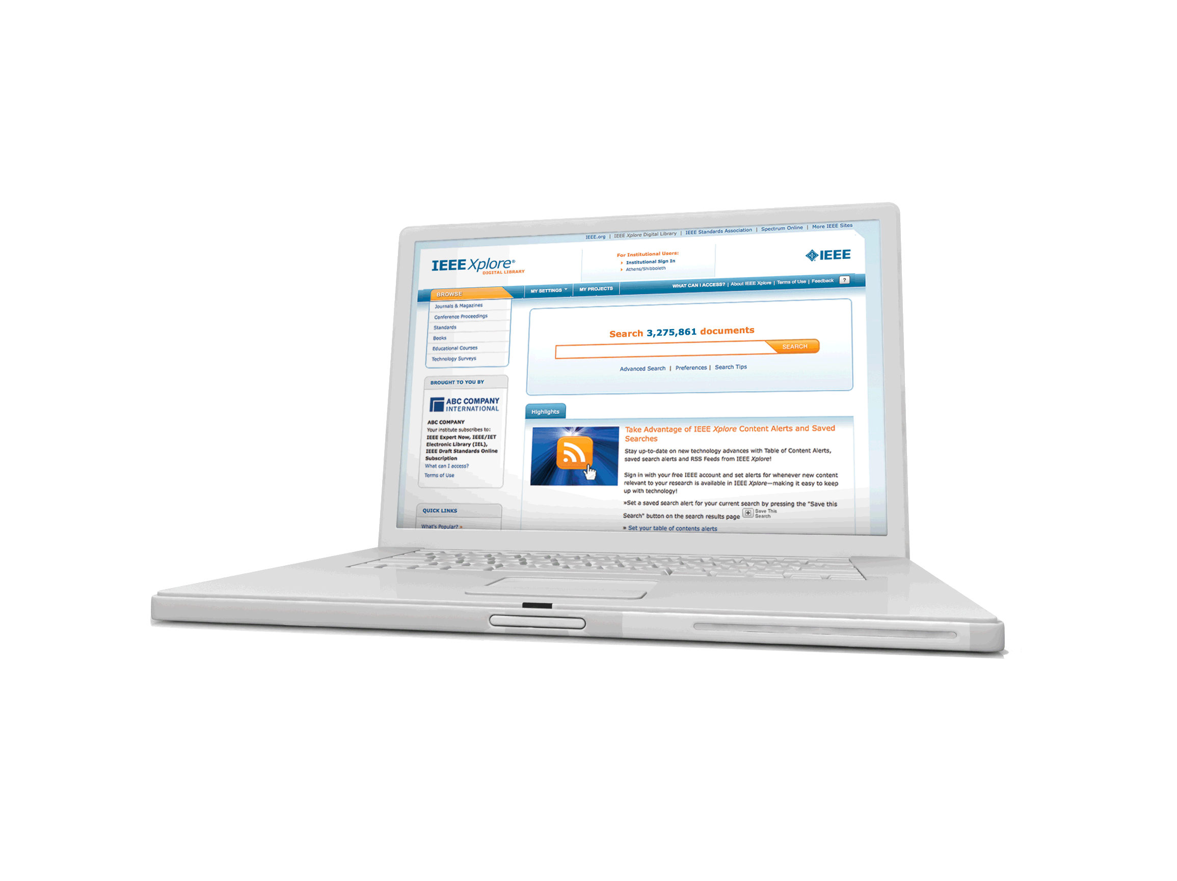
IEEE/IET Electronic Library (IEL)
Your single source of more than 30% of the world’s current literature in electrical engineering, electronics, and computer science.

Slide 7
Full text access to IEEE/IET Electronic Library (IEL)
Nearly four million full text documents
179 IEEE journals & magazines
1400+ annual IEEE conferences + 43 VDE conferences
More than 2800 IEEE standards (active, archived. redlines) + IEEE Standard Dictionary
20 IET conferences, 26 IET journals & magazines
Bell Labs Technical Journal (BLTJ) back to 1922
Backfile to 1988, select legacy data back to 1872
Inspec index records for all articles

Slide 8
IEEE and Patents

Slide 9
IEEE Leads US Patent Citations
Top 20 Publishers Referenced Most Frequently by Top 40 Patenting Organizations
Source: 1790 Analytics LLC 2015. Based on number of references to papers/standards/conferences from 1997-2014

Slide 10
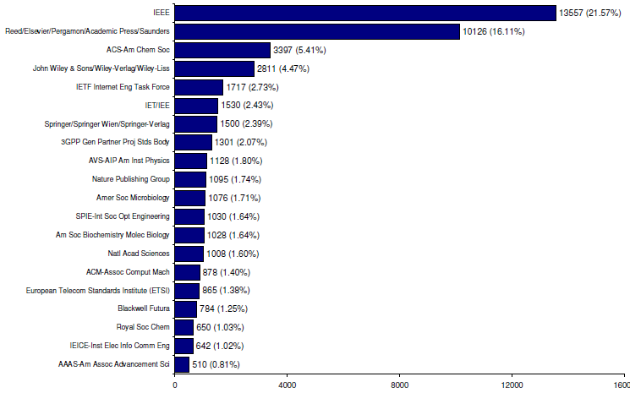
IEEE Leads European Patent Citations
Top 20 Publishers Referenced Most Frequently by Top 25 Patenting Organizations
IEEE is the top cited publisher in patent references from the European Patent Office
Source: 1790 Analytics LLC 2012, , Science References from 1997-2011

Slide 11
Technology areas where patents cite IEEE most
Battery
Computer hardware
Computer software
Information storage
Measuring, testing, and control
Medical devices
Nuclear and X-ray
Optics
Power systems
Robotics
Semiconductors
Smart Grid
Solar/Photovoltaic
Telecommunications
Wind Energy
Source: 1790 Analytics LLC 2015
11
2/15/2017

Slide 12
Content on IEEE Xplore Digital Library

Slide 13
Full text content from all 39 IEEE Societies
IEEE Aerospace and Electronic Systems Society
IEEE Antennas and Propagation Society
IEEE Broadcast Technology Society
IEEE Circuits and Systems Society
IEEE Communications Society
IEEE Components, Packaging, and Manufacturing Technology Society
IEEE Computational Intelligence Society
IEEE Computer Society
IEEE Consumer Electronics Society
IEEE Control Systems Society
IEEE Dielectrics and Electrical Insulation Society
IEEE Education Society
IEEE Electron Devices Society
IEEE Electromagnetic Compatibility Society
IEEE Engineering in Medicine and Biology Society
IEEE Geoscience and Remote Sensing Society
IEEE Industrial Electronics Society
IEEE Industry Applications Society
IEEE Information Theory Society
IEEE Instrumentation and Measurement Society
IEEE Intelligent Transportation Systems Society
IEEE Magnetics Society
IEEE Microwave Theory and Techniques Society
IEEE Nuclear and Plasma Sciences Society
IEEE Oceanic Engineering Society
IEEE Photonics Society
IEEE Power Electronics Society
IEEE Power & Energy Society
IEEE Product Safety Engineering Society
IEEE Professional Communications Society
IEEE Reliability Society
IEEE Robotics and Automation Society
IEEE Signal Processing Society
IEEE Society on Social Implications of Technology
IEEE Solid-State Circuits Society
IEEE Systems, Man, and Cybernetics Society
IEEE Technology and Engineering Management Society NEW in 2015
IEEE Ultrasonics, Ferroelectrics, and Frequency Control Society
IEEE Vehicular Technology Society
Notes:
Which is the oldest?
Which is the biggest?

Slide 14
IEEE covers all areas of technology
More than just electrical engineering & computer science
BIG DATA
MACHINE LEARNING
OPTICS
RENEWABLE ENERGY
SEMICONDUCTORS
SMART GRID
IMAGING
NANOTECHNOLOGY
AEROSPACE
SIGNAL PROCESSING
COMMUNICATIONS
HUMAN-CENTERED INFORMATICS
ELECTRONICS
BIOMEDICAL ENGINEERING
NEXT GEN WIRELESS
CIRCUITS
CLOUD COMPUTING
CYBER SECURITY
ELECTROMAGNETICS

Slide 15
Multidisciplinary Content on IEEE Xplore Digital Library

Slide 16
Life Sciences
At least eight IEEE publications are dedicated in whole or in part to technology related to Life Sciences.
Plus, there are more than 90 annual conferences, 20 periodicals and 20 IEEE standards that cover medical device communications.
In IEEE Xplore, you’ll also find coverage of therapeutic devices used in rehabilitation processes, such as physical therapy and devices used to restore movement and function.
Examples of IEEE publications:
IEEE Pulse
IEEE Trans. on Biomedical Engineering
IEEE Reviews on Biomedical Engineering
IEEE Trans. on Neural Systems and Rehabilitation Engineering
IEEE Trans. on Information Technology in Biomedicine
IEEE Trans. on Medical Imaging
IEEE/ACM Trans. on Computational Biology and Bioinformatics
IEEE Trans. on Biomedical Circuits and Systems
IEEE Trans. on NanoBioscience
IEEE Trans. on Autonomous Mental Development.
Notes:
From 2011 IEEE President Moshe Kam’s article “Life Sciences Spark IEEE Interest” (IEEE Institute March 2011)
http://theinstitute.ieee.org/opinions/presidents-column/life-sciences-spark-ieee-interest857
One of the most interesting and important developments in recent years has been our increased focus on the life sciences and their applications. IEEE now regularly publishes eight refereed publications in this area and organizes conferences on subjects such as bioinformatics and clinical applications of medical image analysis. You can find more than 900 articles in our archives on tissue engineering alone, as well as hundreds of articles on regenerative medicine, cell engineering, and stem cells.
Advances in life sciences such as cell biology, genomics, and pharmacology, as well as society’s desire to improve health care, have led to a need for more of what IEEE has to offer: statistical methods, image analyses, diagnostic devices, and medical equipment standards, to name just a few contributions. They all involve electrical and computer engineering and computer science—areas in which IEEE has a wealth of experience.

Slide 17
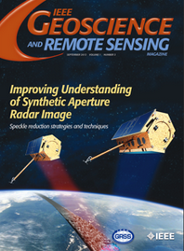
Geoscience and related fields
IEEE’s geoscience and remote sensing publications cover the fusion of engineering and geoscientific fields including geophysics, geology, hydrology, meteorology, etc.
In IEEE Xplore, you’ll also find information relevant to natural resources engineering and mineral resources engineering, including extensive coverage of technologies related to oil and gas exploration, drilling operations, offshore oil rigs and mining.
Examples of IEEE publications:
IEEE Trans. on Geoscience & Remote Sensing
IEEE Geoscience & Remote Sensing Magazine
IEEE Geoscience & Remote Sensing Letters
IEEE International Symposium Geoscience and Remote Sensing (IGARSS)
IEEE Petroleum and Chemical Industry Technical Conference (PCIC)
Notes:
From Society Website: http://www.grss-ieee.org/about/

Slide 18
Manufacturing Engineering
IEEE’s publications cover manufacturing practices and technologies, including the development of systems, processes, machines, and tools.
In IEEE Xplore, you’ll find information on virtual manufacturing, computer integrated manufacturing, agile manufacturing, quality control, robotics and automation, mechatronics, and much more
Relevant IEEE publications include:
IEEE/ASME Transactions on Mechatronics (#1 most cited journal in Engineering – Manufacturing)
IEEE Transactions on Components, Packaging and Manufacturing Technology
IEEE Transactions on Semiconductor Manufacturing
IEEE Transactions on Automation Science and Engineering
IEEE Robotics & Automation Magazine
IEEE International Symposium on Assembly and Manufacturing
International Conference on Digital Manufacturing and Automation
e-Manufacturing & Design Collaboration Symposium Electronics Manufacturing Technology Symposium
International Conference on System Science, Engineering Design and Manufacturing Informatization
Notes:
From Society Website: http://www.grss-ieee.org/about/

Slide 19
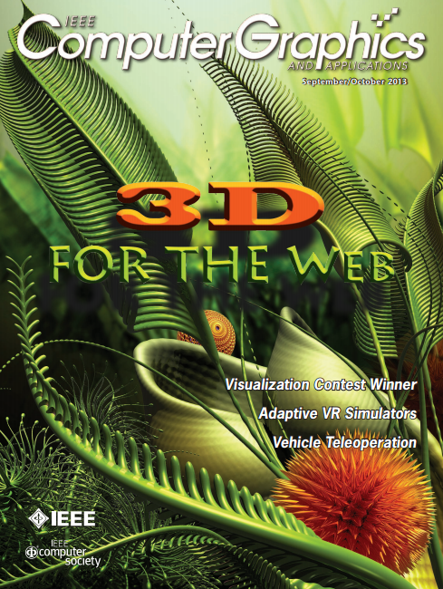
Digital Art & Technology
IEEE Xplore covers the leading edge of computer graphics technology and its applications in everything from business to the arts.
Topics include computer graphics, design, animation, 3D, user interface, motion graphics, and more
Examples of IEEE Xplore publications:
IEEE Computer Graphics
IEEE Trans. On Visualization & Computer Graphics
International Conference on Computer-Aided Design & Computer Graphics
International Conference on Computer Graphics, Imaging & Visualization
International Conference on Image & Graphics

Slide 20
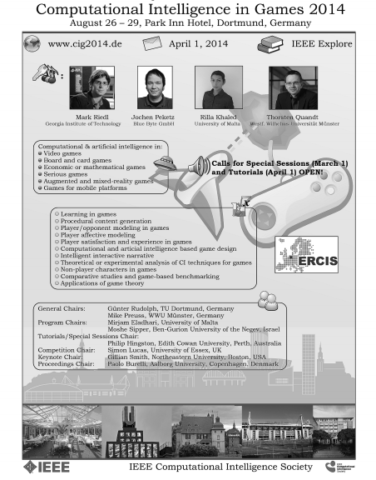
Game Design
IEEE Xplore covers the design of video games, mathematical games, human-computer interactions in games, and games involving physical objects.
Topics include game production, computational intelligence, artificial intelligence, simulations, and more
Examples of IEEE Xplore publications:
IEEE Trans. On Computational Intelligence and AI in Games
Symposium on Computational Intelligence in Games
International Conference on Computer Games
International Workshop on Digital Game and Intelligent Toy Enhanced Learning
International Symposium on Haptic, Audio, Visual Environments and Games

Slide 21
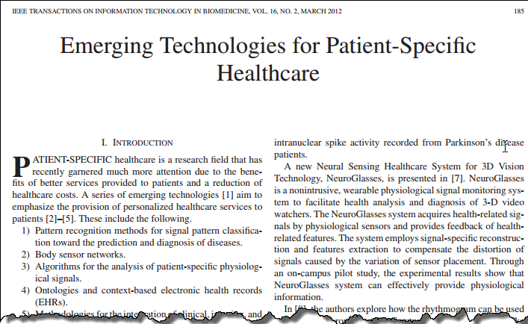
With IEEE Xplore, learn how technology impacts fields such as…
Healthcare: telemedicine, electronic medical records, patient-specific healthcare, cloud computing in the medical field, patient monitoring systems, informatics, and more

Slide 22
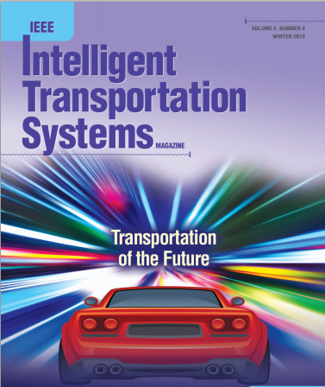
With IEEE Xplore, learn how technology impacts fields such as…
Transportation: intelligent transportation systems, logistics, supply chain management, and more
Related IEEE Journals & Conferences:
IEEE Trans. on Intelligent Transportation Systems
IEEE Intelligent Transportation Systems Magazine
IEEE Trans. on Automation Science and Engineering
IEEE International Conference on Automation and Logistics

Slide 23
With IEEE Xplore, learn how technology impacts fields such as…
Business & Finance: information systems, project management, risk management, business informatics, R&D project selection and evaluation, IT investment justification, innovation, and more
Read articles by leaders in the field:
Prof. Clayton Christensen
Harvard Business School
“Innovator’s Dilemma”
http://www.claytonchristensen.com/
Prof. Tony Cai
The Wharton School of the University of Pennsylvania

Slide 24
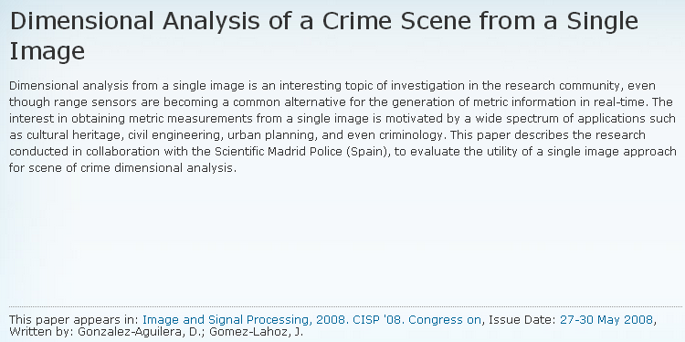
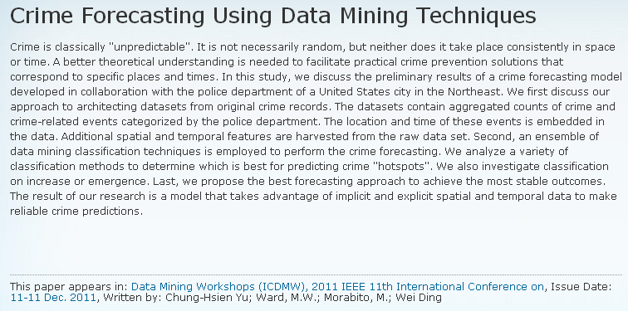
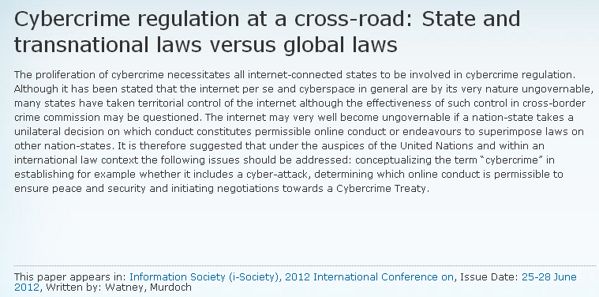
With IEEE Xplore, learn how technology impacts fields such as…
Criminal Justice: crime scene investigation technologies, cybercrime, crime statistics, and more

Slide 25
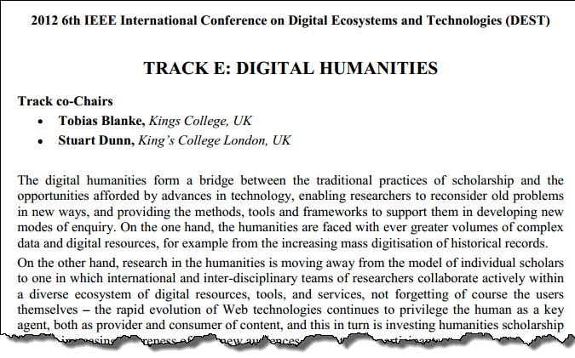
With IEEE Xplore, learn how technology impacts fields such as…
Liberal Arts: digital humanities, use of image processing in art conservation, music classification, and more

Slide 26
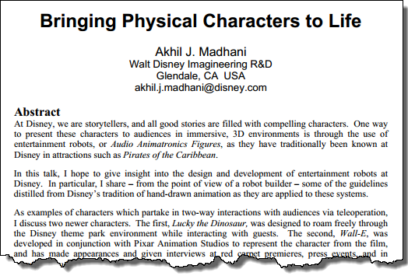
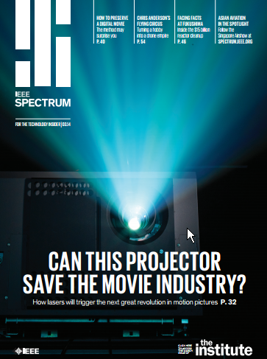
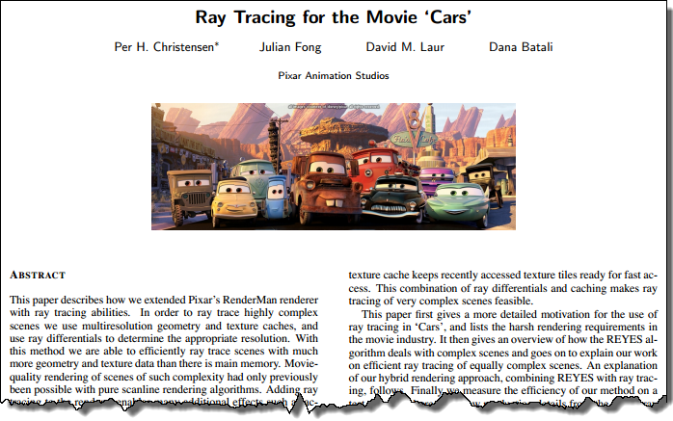
With IEEE Xplore, learn how technology impacts fields such as…
Entertainment: computer graphics, animation, 3D, digital motion pictures, laser projectors, and more

Slide 27
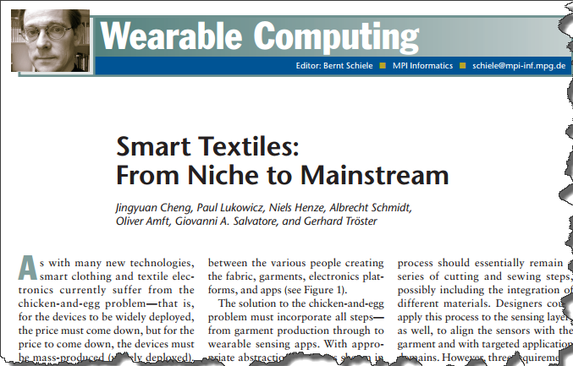
With IEEE Xplore, learn how technology impacts fields such as…
Apparel Design: e-textiles, smart fabrics, intelligent clothing, wearable computing, and more

Slide 28
New IEEE Journals Planned for 2017
In 2017, IEEE will introduce six new journals that will be available for subscription:
IEEE Communications Standards Magazine
IEEE Journal of Electromagnetics, RF and Microwaves in Medicine and Biology
IEEE Transactions on Emerging Topics in Computational Intelligence
IEEE Transactions on Green Communications and Networking
IEEE Transactions on Radiation and Plasma Medical Sciences
IEEE Journal of Radio Frequency Identification
All Included in an IEL Subscription
For a complete title listing, to go: http://ieeexplore.ieee.org/xpl/opacjrn.jsp

Slide 29
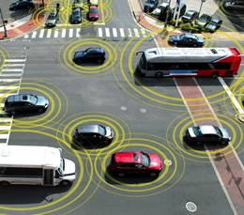
New IEEE Journals Coming in 2016
In 2016, IEEE will introduce four new journals that will be available for subscription:
IEEE Transactions on Intelligent Vehicles
IEEE Journal on Multiscale and Multiphysics Computational Techniques
IEEE Robotics and Automation Letters
IEEE Transactions on Sustainable Computing
All included in an IEL subscription
For a complete title listing, to go: http://ieeexplore.ieee.org/xpl/opacjrn.jsp

Slide 30
New IEEE Journals from 2015
IEEE Trans. on Big Data
IEEE Trans. on Transportation Electrification
IEEE Trans. on Cognitive Communications and Networking
IEEE Trans. on Computational Imaging
IEEE Trans. on Molecular, Biological, and Multi-Scale Communications
IEEE Trans. on Multi-Scale Computing Systems
IEEE Trans. on Signal and Information Processing over Networks
IEEE Systems, Man, and Cybernetics Magazine
All included in an IEL subscription
For a complete title listing, to go: http://ieeexplore.ieee.org/xpl/opacjrn.jsp
30
2/15/2017

Slide 31
A sampling of some of the new conferences added in 2015
Big Data Software Engineering (BIGDSE), 2015 IEEE/ACM 1st International Workshop on
Computational Electromagnetics (ICCEM), 2015 IEEE International Conference on
DC Microgrids (ICDCM), 2015 IEEE First International Conference on
Electromagnetic Compatibility and Signal Integrity, 2015 IEEE Symposium on
Identity, Security and Behavior Analysis (ISBA), 2015 IEEE International Conference on
Industrial Engineering and Operations Management (IEOM), 2015 International Conference on
Microwaves for Intelligent Mobility (ICMIM), 2015 IEEE MTT-S International Conference on
Multimedia Big Data (BigMM), 2015 IEEE International Conference on
Networking Systems and Security (NSysS), 2015 International Conference on
Sampling Theory and Applications (SampTA), 2015 International Conference on
Signal Processing, Informatics, Communication and Energy Systems (SPICES), 2015 IEEE International Conference on
Smart Cities Conference (ISC2), 2015 IEEE First International
Notes:
.

Slide 32
Examples of New IEEE Conferences in 2014
Internet of Things (WF-IoT), 2014 IEEE World Forum on
Humanitarian Technology Conference, (IHTC), 2014 IEEE Canada International
Aerospace Electronics and Remote Sensing Technology (ICARES), 2014 IEEE International Conference on
Antenna Measurements & Applications (CAMA), 2014 IEEE Conference on
Consumer Electronics, Taiwan (ICCE-TW), 2014 IEEE International Conference on
Energy Conversion (CENCON), 2014 IEEE Conference on
Ethics in Science, Technology and Engineering, 2014 IEEE International Symposium on
Transportation Electrification Asia-Pacific (ITEC Asia-Pacific), 2014 IEEE Conference and Expo
Intelligent Energy and Power Systems (IEPS), 2014 IEEE International Conference on
Quantum Optics Workshop (QOW), 2014
Sensor Systems for a Changing Ocean (SSCO), 2014 IEEE
Wireless and Mobile, 2014 IEEE Asia Pacific Conference on
Industrial Engineering and Information Technology (IEIT), 2014 International Conference on
Guidance, Navigation and Control Conference (CGNCC), 2014 IEEE Chinese
Notes:
.

Slide 33
A sampling of some of the new conferences added in 2016
Cloud Computing and Big Data Analysis (ICCCBDA), 2016 IEEE International Conference on
Computer Communication and the Internet (ICCCI), 2016 First IEEE International Conference on
Connected Health: Applications, Systems and Engineering Technologies (CHASE), 2016 IEEE First International Conference on
Control, Measurement and Instrumentation (CMI), 2016 IEEE First International Conference on
Electrical Systems for Aircraft, Railway, Ship Propulsion and Road Vehicles & International Transportation Electrification Conference (ESARS-ITEC), 2016 International Conference on
Intelligent Systems Engineering (ICISE), 2016 International Conference on
Intelligent Transportation Engineering (ICITE), 2016 IEEE International Conference on
Mechatronics, Adaptive and Intelligent Systems (MAIS), 2016 IEEE Conference on
Power Electronics, Intelligent Control and Energy Systems (ICPEICES), 2016 IEEE 1st International Conference on
The Science of Electrical Engineering (ICSEE), 2016 IEEE International Conference on
Notes:
.

Slide 34
Popular IEEE Standards
IEEE 802 Series—IEEE Standard for Ethernet
IEEE 3000 Standards Collection™—Formerly the IEEE Color Books®, this collection will reorganize the 13 Color Books into approximately 70 “dot” standards covering specific technical topics on all facets of industrial and commercial power systems.
IEEE 81-2012™—IEEE Guide for Measuring Earth Resistivity, Ground Impedance, and Earth Surface Potentials of a Grounding System
2017 National Electrical Safety Code® (NESC®)—Sets the ground rules for practical safeguarding of persons during the installation, operation, or maintenance of electric supply and communications lines and associated equipment.
IEEE 43™—IEEE Recommended Practice for Testing Insulation Resistance of Electric Machinery
IEEE 80™—IEEE Guide for Safety in AC Substation Grounding
IEEE 81™—IEEE Guide for Measuring Earth Resistivity, Ground Impedance, and Earth Surface Potentials of a Grounding System
34
2/15/2017

Slide 35
Setting up Rooming Mobile Access
Off-campus/Remote Access for laptop, tablet, phone

Slide 36
Roaming Mobile Access
Allows for access to IEEE Xplore content when users are off-campus
Can be set-up for multiple devices – laptop, tablet, phone
Available for 90 days
To initiate:
Login to IEEE Xplore from within your institution’s IP range
Sign In with a personal IEEE Account
Select My Settings > Remote Access
Libraries can have this feature enabled by contacting Online Support (onlinesupport@ieee.org) IT IS ENABLED for Cons. MEMBERS in RUSSIA

Slide 37
Roaming Mobile Access - How Roaming Access setup appears on IEEE Xplore:

Slide 38
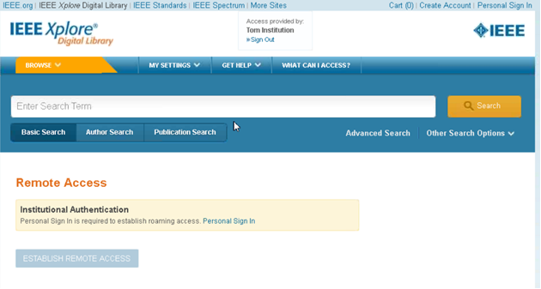
Roaming Mobile Access - User prompted to create/sign in with personal IEEE account:

Slide 39
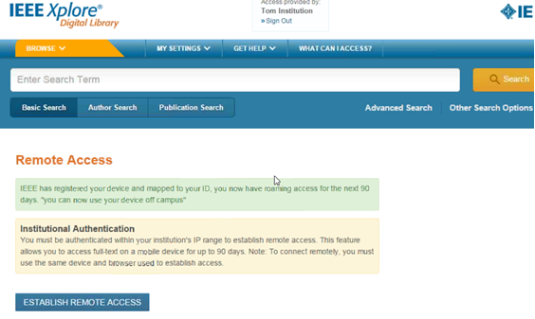
Roaming Mobile Access – Select Establish Remote Access to pair mobile device:

Slide 40
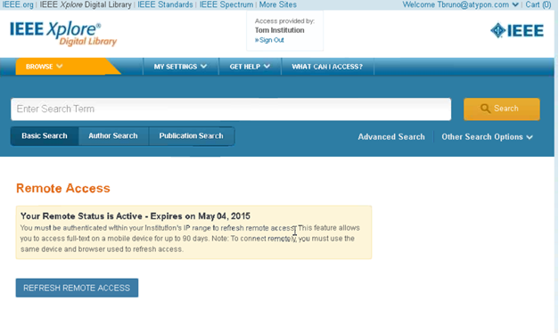
Roaming Mobile Access – Every 90 days refresh remote access:

Slide 41
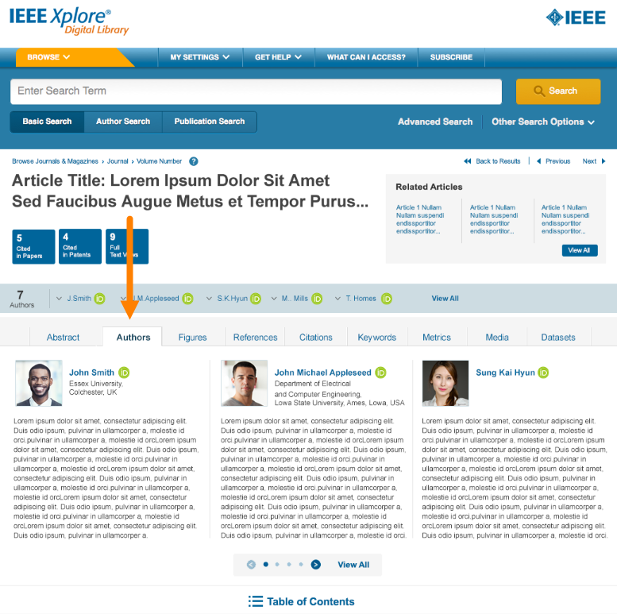
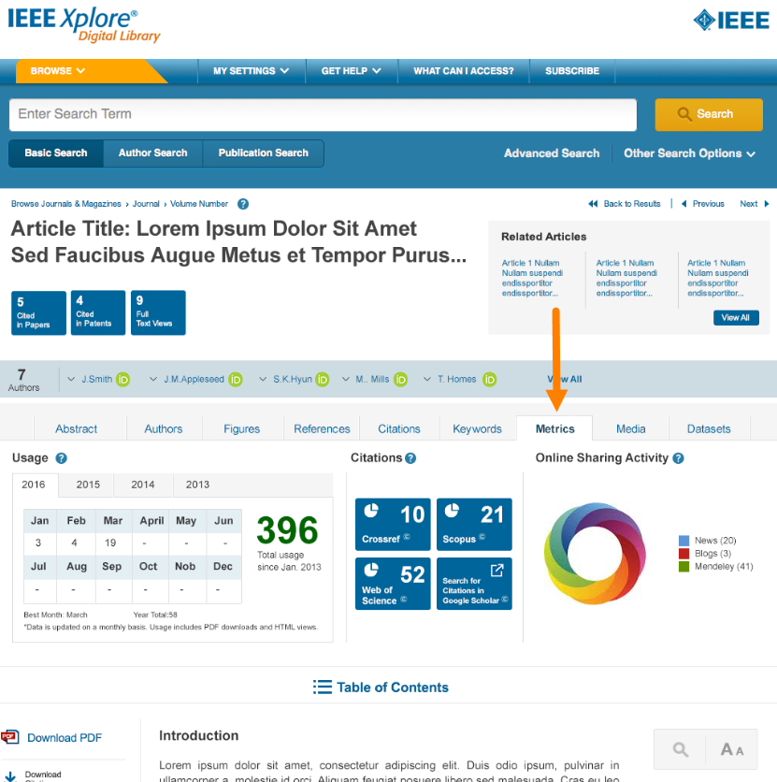
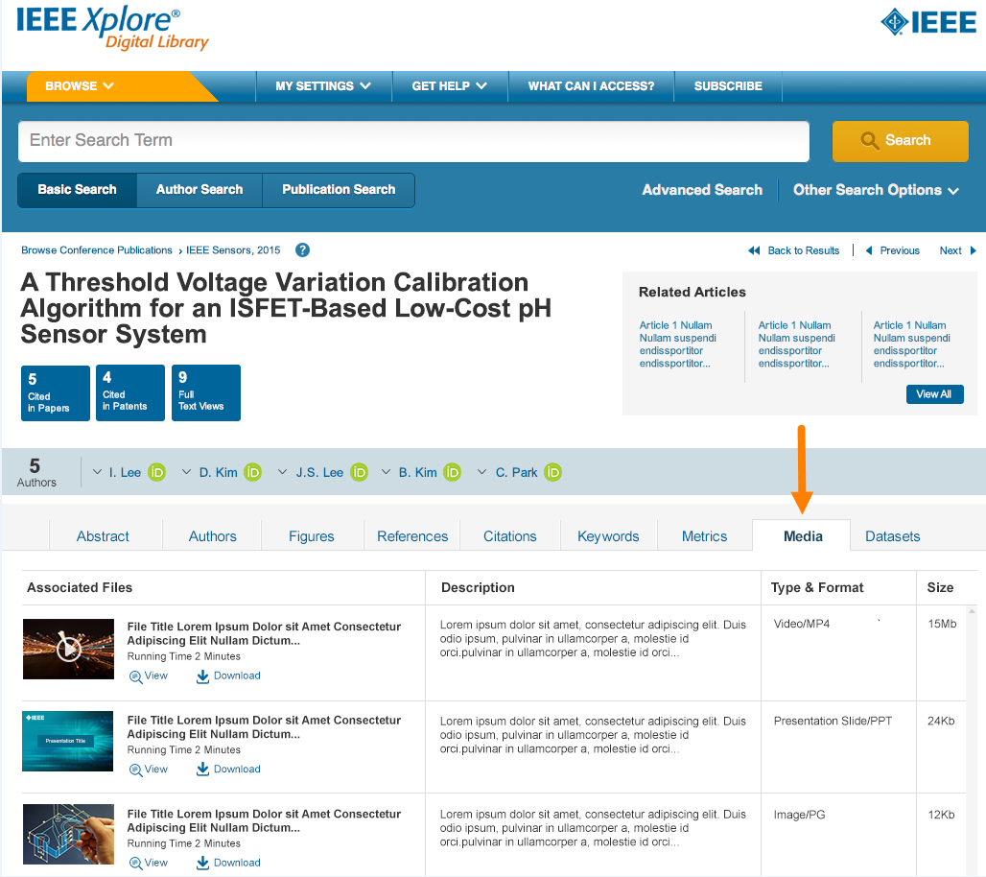
Redesign of Full-Text HTML Articles
More prominent
article metrics
related articles
featured media
Author’s ORCID identifier & bio
Metrics gallery
Multimedia gallery

Slide 42
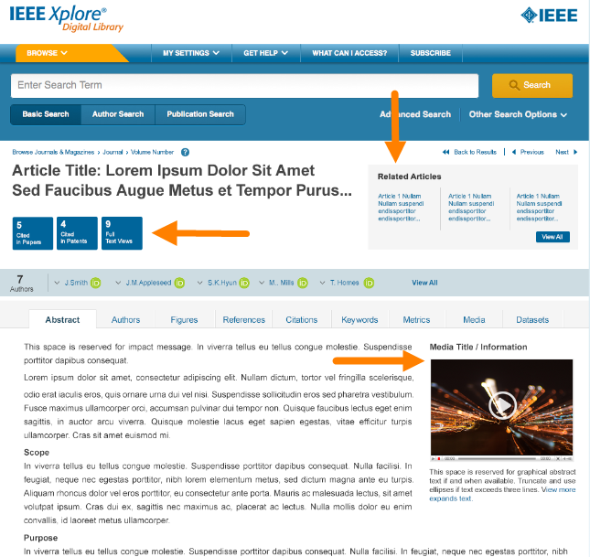
Redesign of Full-Text HTML Articles
More prominent
article metrics
related articles
featured media
Author’s ORCID identifier & bio
Metrics gallery
Multimedia gallery

Slide 43
Secondary Author Affiliation
Secondary author affiliations are now available on the new blended full text HTML/abstract page. Users will also be able to search for secondary authors based on their affiliation (like you would for a primary author).

Slide 44
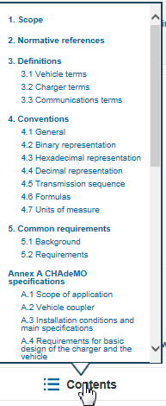
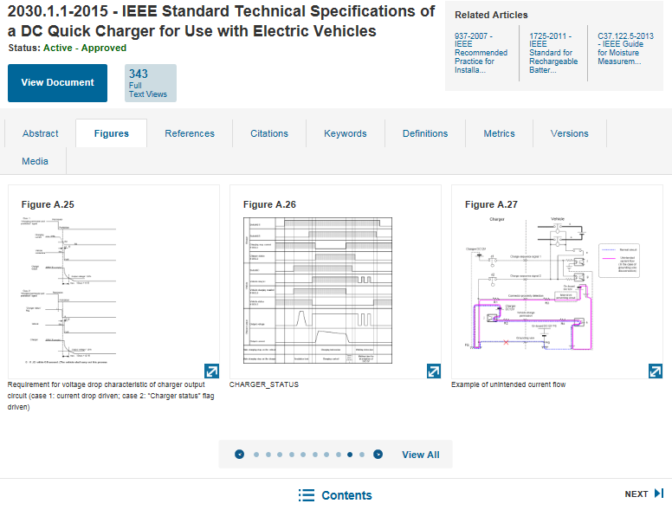
NEW! Full-Text HTML for Standards
Modern, mobile-friendly design
Figures carousel
Table of contents within Standard
Search within a Standard
Evolution of the Standard

Slide 45
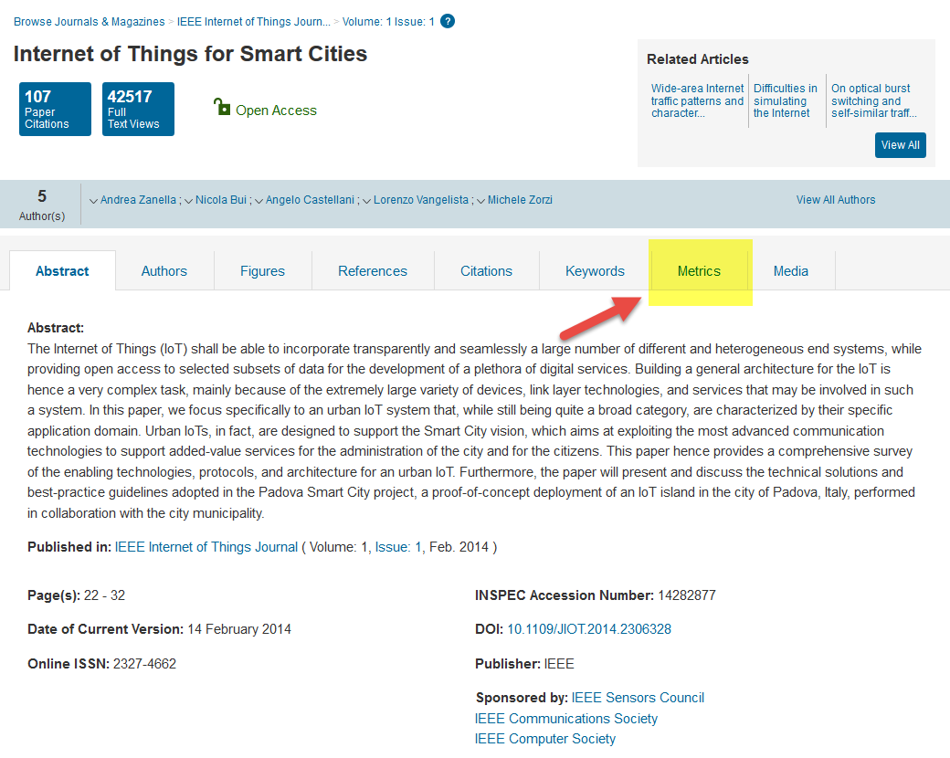
NEW! Enhancing Metrics: Altmetrics

Slide 46
IEEE Xplore Demonstration
Start with Basic Search on Xplore homepage
Create a relevant search for the client
Show type-ahead as a way to define the search and highlight content in Xplore
Sort by newest first
Sort by most cited
Explain Action Bar (including how to save a search)

Slide 47
Customize Searches for Clients
Perform an affiliation search
Look at customer’s website
Review usage statistics
What is the customer’s industry focus & key technologies?
Competitors (affiliation search useful)

Slide 48
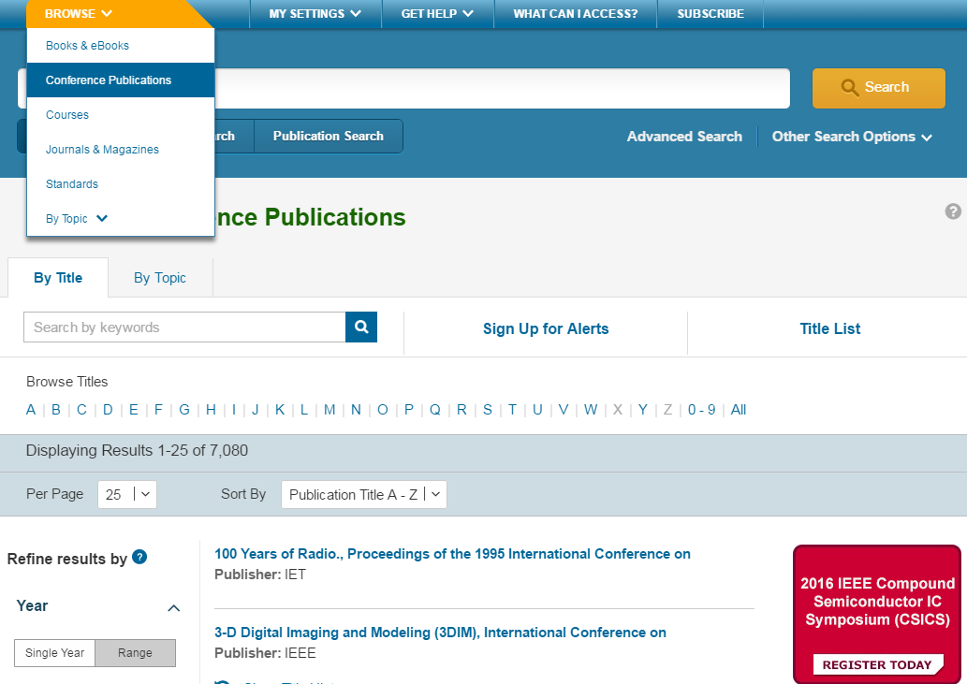
Browsing the Table of Contents

Slide 49
Basic Search
The Basic Search function searches metadata only
Automatically ORs each search term
Use quotes (“ ”) for an exact phrase
Automatic stemming
Case insensitive
Type ahead (aka auto suggest) functionality

Slide 50
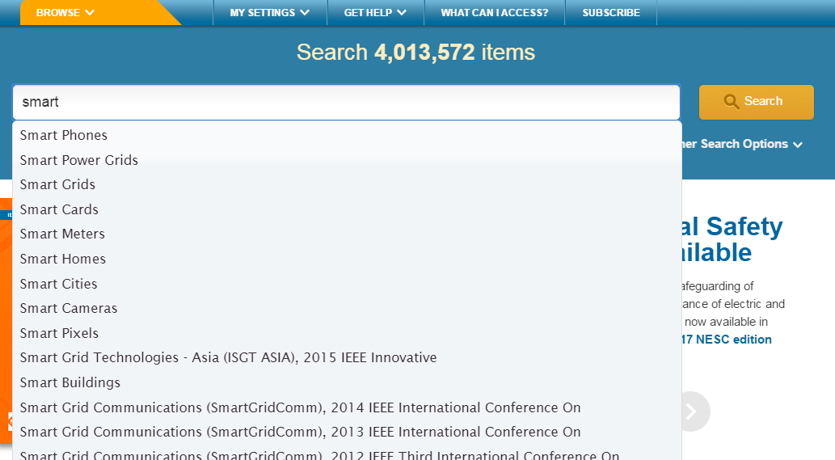
Type Ahead Feature – Explore Related Topics

Slide 51
Type Ahead Feature
Type Ahead offers search suggestions as users type a term into a search box
Xplore shows a maximum of 20 suggestions
Ranking is based on “starts with”
Based on a sub-set of fields:
Publication Title
Subject
Index Terms
When a user selects one of the type-ahead terms, Xplore searches against all fields (Metadata)

Slide 52
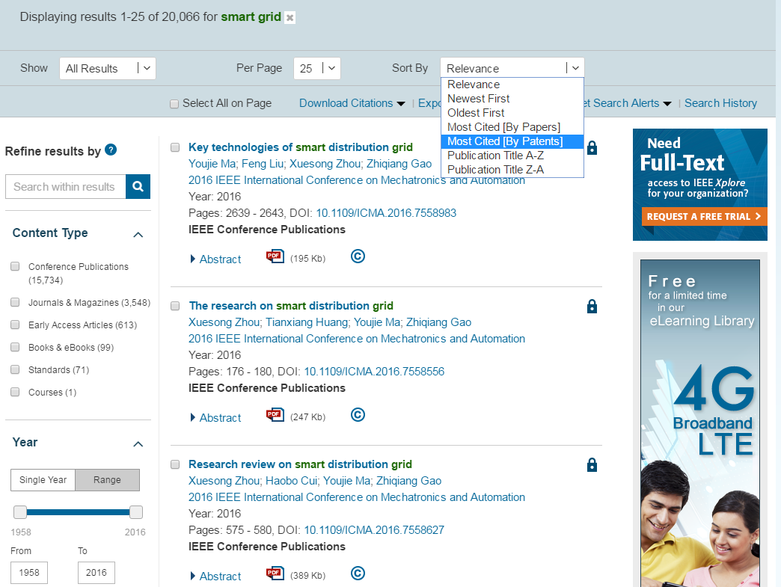
Search Results and Refinements

Slide 53
IEEE Xplore Facets
Review list of facets:
Content Type: Early Access and Draft Standards are a window into the future of technology
Author Affiliation: Useful for competitive intelligence and to identify potential partners
Publication Title: Helpful in identifying relevant conferences and journals to read

Slide 54
Relevancy Ranking Relevancy Ranking refers to the ordering of search results by criteria that are relative to the search terms
Order | Module | Description
1 | NTerms | Ranks results based on the number of terms that match. In a multi-word search, the more words that match, the higher the ranking.
2 | Field | Ranks results based on the priority assigned by the search interface to searchable fields and their dimensions.
3 | Phrase | Ranks matches that contain the user's query as an exact phrase higher than matches that contain the user's search terms separated in text.
4 | Frequency | Ranks results based on the number of times search terms appear in the article.

Slide 55
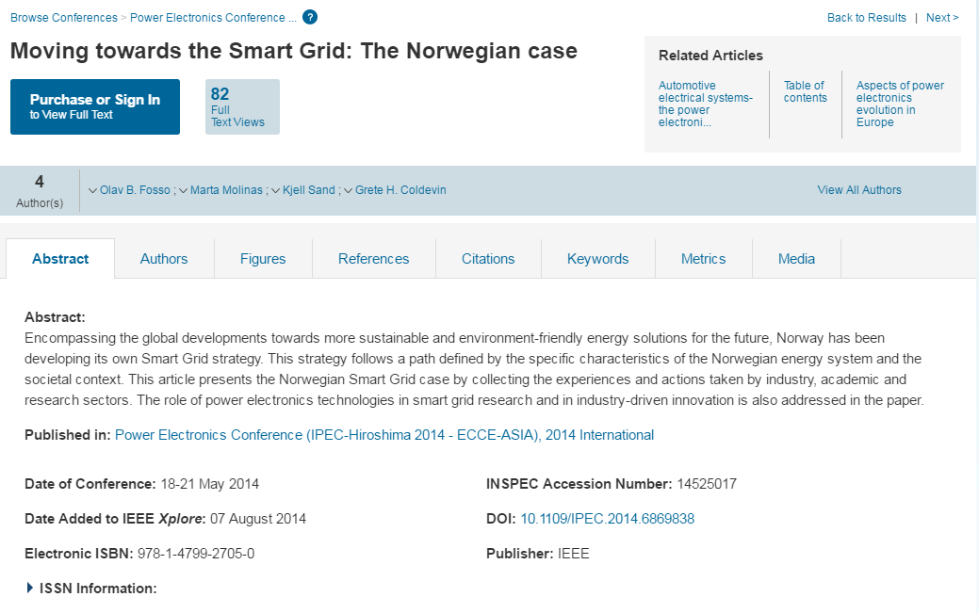
New! Unified Abstract & HTML View

Slide 56
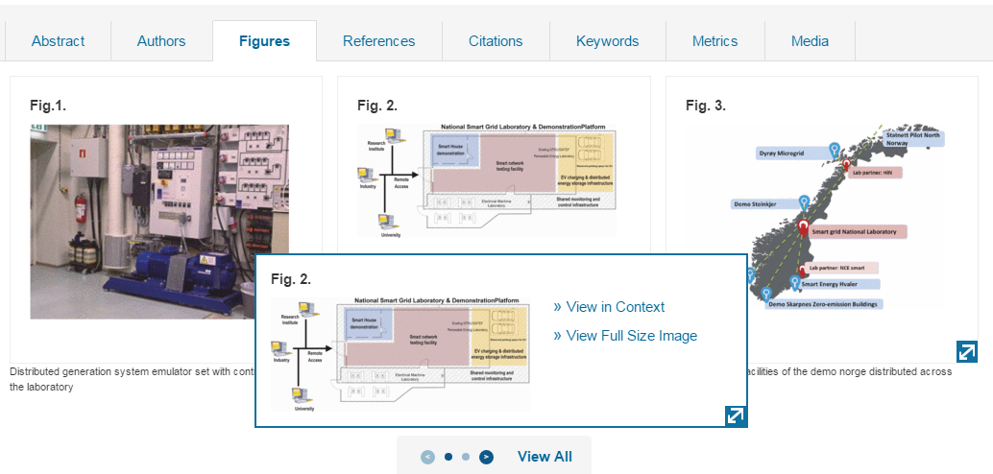
View Figures

Slide 57
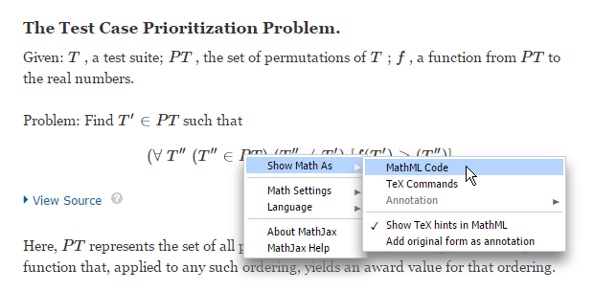
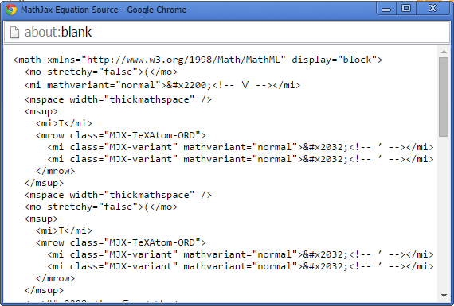
Equations: Copy Source Code

Slide 58
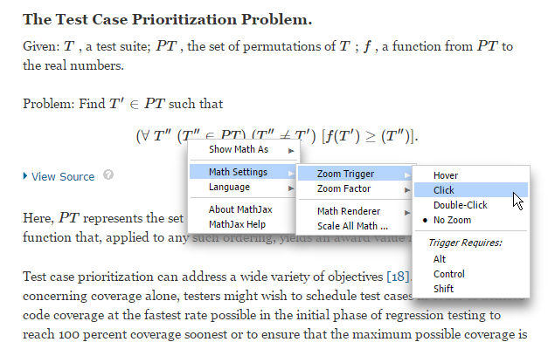
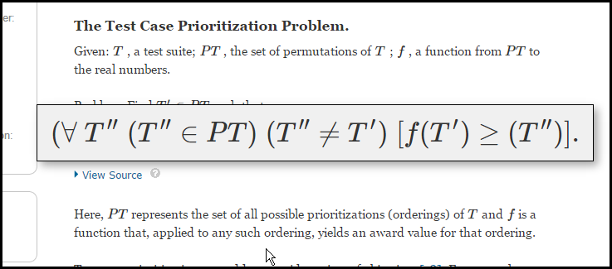
Equations: Zoom Function

Slide 59
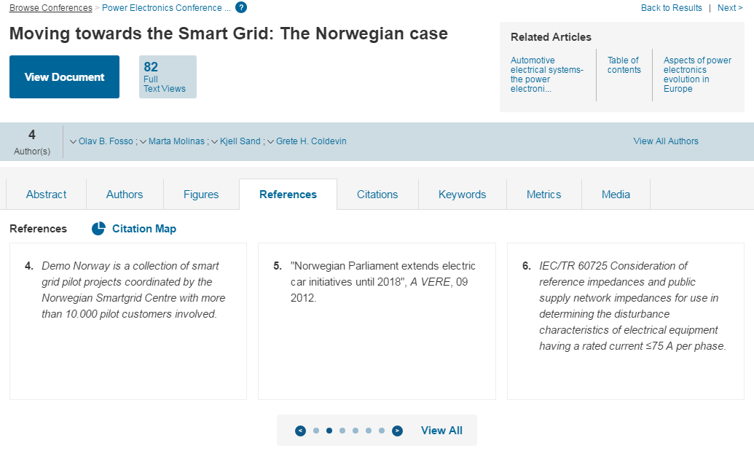
References, Citations & Citation Map

Slide 60
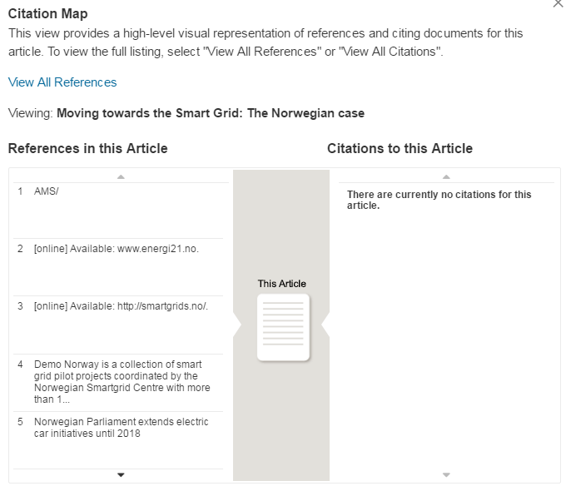
References, Citations & Citation Map

Slide 61
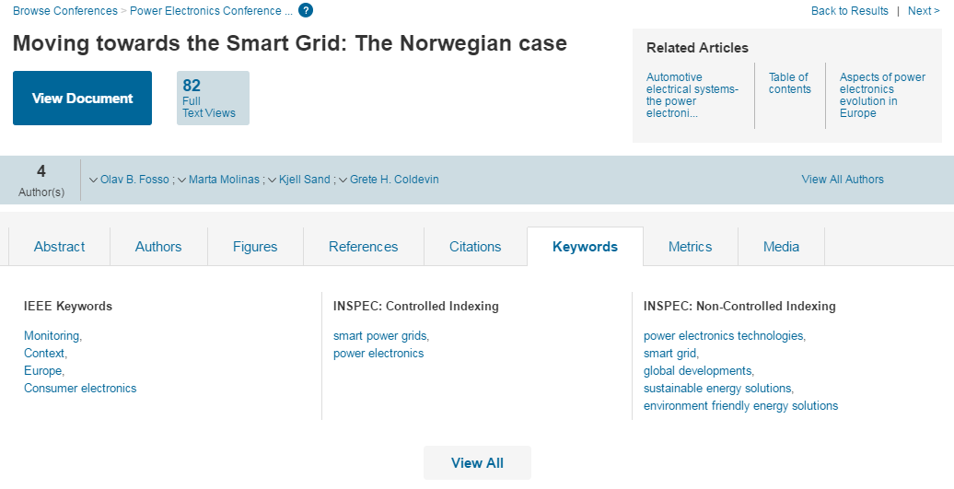
Keywords

Slide 62
Advanced Search
Guided way to do more complex searching
Use operators (AND, OR, NOT) to have more control over search
Ability to search full-text, as well as search within specific fields, such as title, author and abstract
Create a relevant search for the prospect
Topical search, author affiliation search or standards search

Slide 63
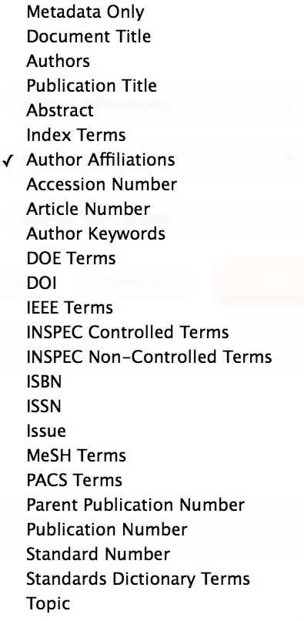
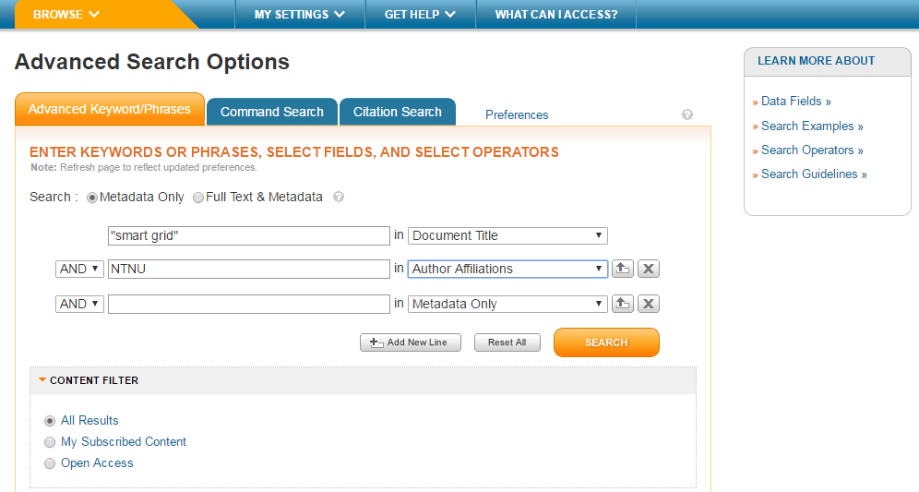
Advanced Search - Affiliation & Fields

Slide 64
Advanced Search
Access from the link below the Global Search Box
Default searches the Metadata
Can search Full-Text and Metadata by selecting radio button
Can search within specific fields such as Author and Index Terms by using the drop down menu
Can add up to ten search boxes
Combine search terms/phrases with AND, OR, NOT
Use ASCII "quotes" for an exact phrase
Automatic Stemming
Pluralized nouns (computer=computers)
Verb tenses (run=running, ran, etc.)
British and American spelling variations (fiber=fibre)

Slide 65
Asterisk (Wildcard) Rules
The * wildcard can be used at the end of a word, at the beginning of a word, or in the middle of a word
Must have at least 3 characters to use the * wildcard
Can not use the * wildcard when searching full-text
Can not use the * wildcard with proximity operators (NEAR and ONEAR)
Can not use the * wildcard within quotes for an exact phrase
Limited to five * wildcards per search
Simulate* will find simulates and simulated but NOT simulating
Simulat* will find simulating, simulated, simulates, simulator, simulation, etc.

Slide 66
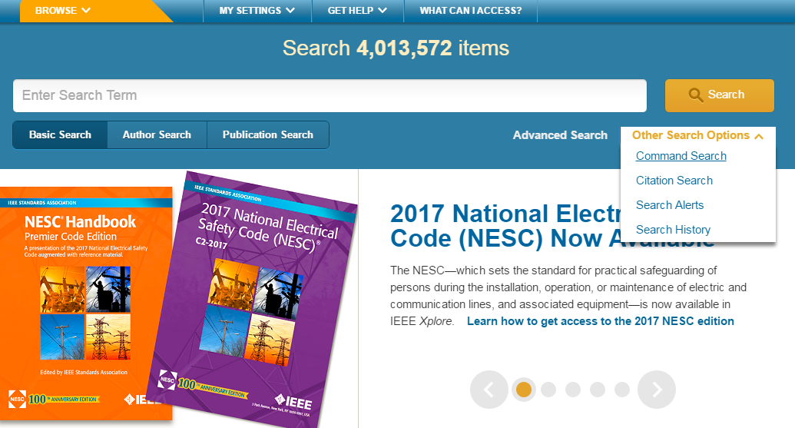
Command Search

Slide 67
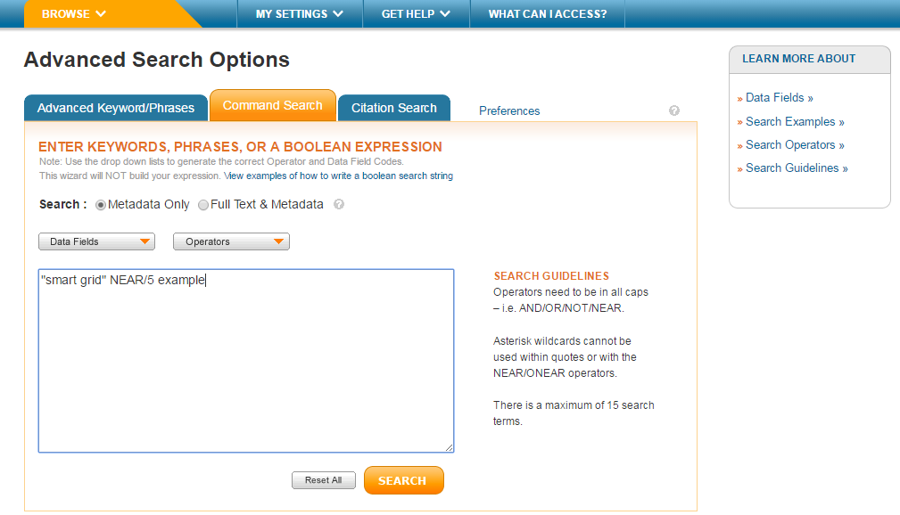
Command Search

Slide 68
Command Search – “AND” vs. “NEAR” in Metadata Only
800 results (AND) vs. 57 (NEAR)

Slide 69
Command Search – “AND” vs. “NEAR” in Full Text
23,955 results (AND) vs. 854 (NEAR)

Slide 70
Command Search
Operator | Syntax | Find Results That...
AND | x AND y | Match both expressions x and y Example: “wireless sensor network” AND security Finds articles with both the phrase wireless sensor network and the word security
OR | x OR y | Match either expression x or y or both Example: REV OR “renewable energy vehicle” Finds articles with either the word REV or the phrase renewable energy vehicle
NOT | x NOT y | Match expression x but not y Example: gasoline NOT diesel Finds articles that include the word gasoline but do not include the word diesel
NEAR | x NEAR/# y | Match expression x within # words of y (x can appear before or after y - NEAR does not designate order) Example: cardiac NEAR/3 implantable Finds articles with the word cardiac within three words of implantable; cardiac can come before or after implantable.
ONEAR | x ONEAR/# y | Match expression x before and within # words of y (ONEAR does designate order) Example: cardiac ONEAR/3 implantable Finds articles with the word cardiac within three words of implantable; cardiac must come before implantable.

Slide 71
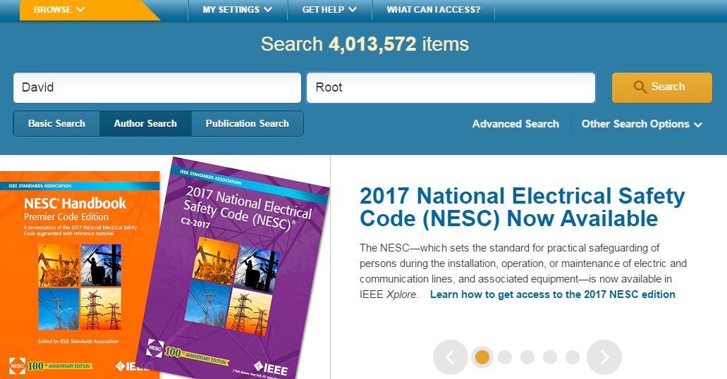
Author Search

Slide 72
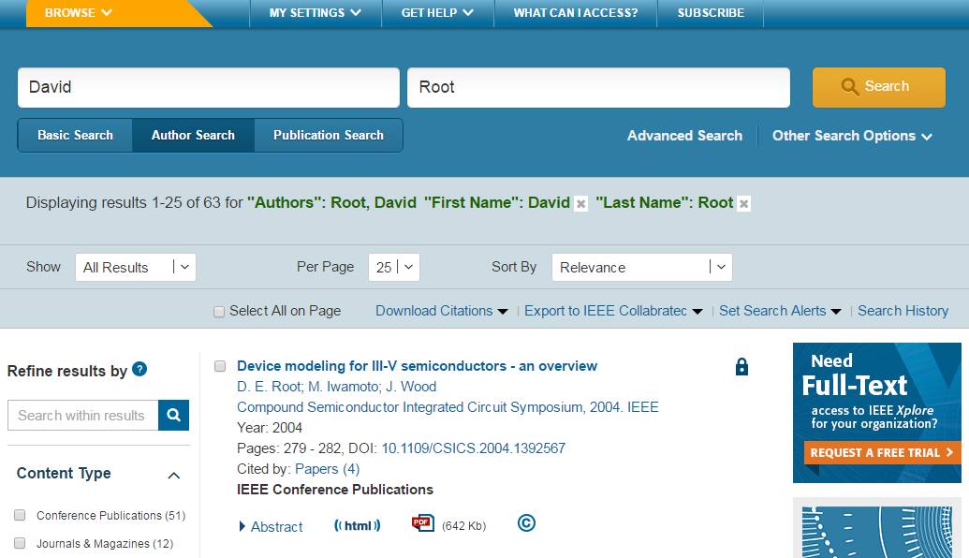
Author Search

Slide 73
Author Search
Author search interface: Select “Author Search” to reveal search fields for First Name, Middle Initial, and Last Name.
Recall of results: Searching for David Root will also retrieve any articles this individual published under D. Root, D.E. Root, or any other variation.
Filter and refine search results: Refine your search by choosing a normalized author name in the author facet on the search results page to retrieve any article linked to that author, regardless of the original name variation used on the article. The name displayed in the author facet is the longest possible version of the author’s name (in our example: David E. Root).

Slide 74
IEEE Personal Account Registration
To take advantage of personalization features, such as search preferences and saved search alerts, users need to create an IEEE account by selecting the “Create Account” link on the top of any IEEE web page.

Slide 75
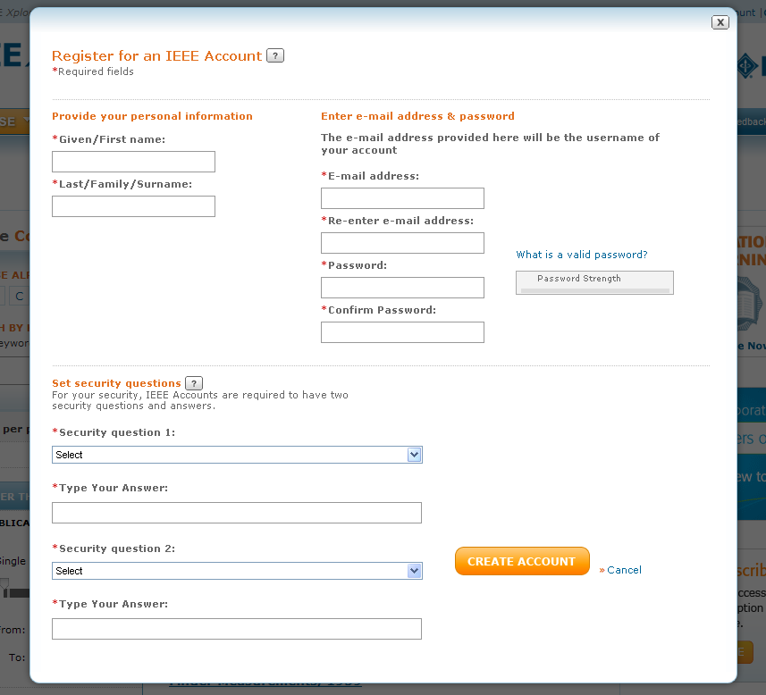
IEEE Personal Account Registration
The IEEE account registration process is an easy 3-click process – just fill out your First Name, Last Name, email address, password and two security questions. Your username is your email address.

Slide 76
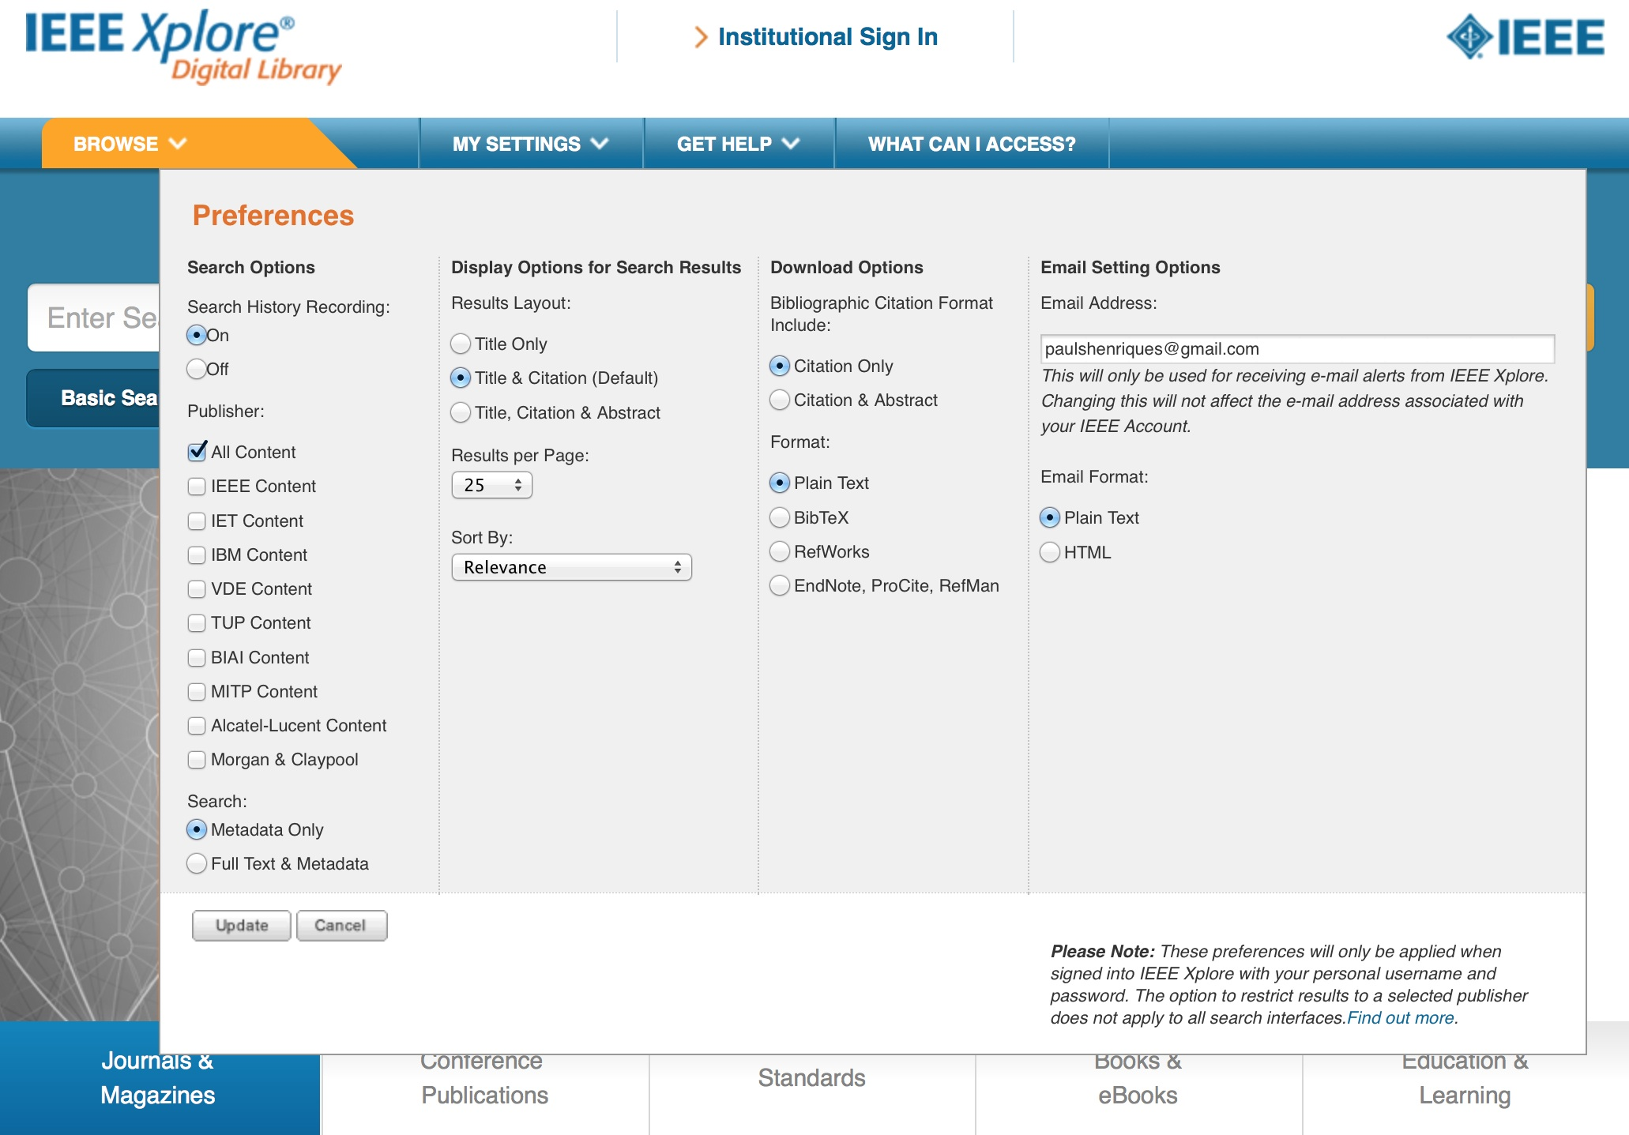
Set Preferences with a Personal Account

Slide 77
Features to save IEEE content:
Download citation to build a bibliography
Export Results into a multi field CSV download. Limit of 2000 records
Saved Searches/Set Alert (IEEE Personal Account). Search is run every Friday. Limit of 15 searches
Export to IEEE Collabratec

Slide 78
IEEE Xplore Demonstration
Alerts
Stay up to date on the latest trends, competitor activity, etc.
Show a screenshot of an alert relevant to the prospect’s area of research
Browse
Highlight relevant conferences, journals, and standards
Users can identify subject matter experts by using the eLearning module and then search for additional papers that they've written in Xplore

Slide 79
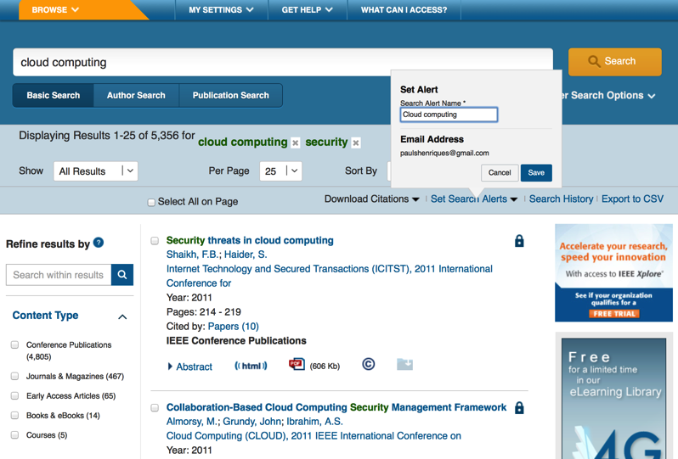
Saved Searches/Table of Content Alerts

Slide 80
Saved Searches/Table of Content Alerts

Slide 81
Saved Searches: Tips
Users can save any search from the search results page
Access Saved Searches from the My Settings drop-down menu
Each user can save up to 15 searches
Broad searches work best
Any refinements made on the search results page will be included in the saved searches
Do not use the publication date field or facet (or the saved search will expire at the end of the year)
Users will receive an email once a week with a link to any new content added to Xplore that meets their search criteria

Slide 82
Organize Your Research with IEEE Collabratec

Slide 83
Export Documents to Collabratec

Slide 84
Resources and Help Section

Slide 85
Resources and Help

Slide 86
Client Services Page (via Resources and Help Section)

Slide 87
Free courses availbele for customers
Techniques for effective research with IEEE Xplore (45 minutes with Tatiana Kalinina OR Eszter Lukacs, online or onsite) RUSSIAN OR ENGLISH
How to get published with the IEEE? (90 minutes, with Eszter Lukacs, online or onsite) - ENGLISH
Patent searching best practices with IEEE Xplore (45 minutes with Eszter Lukacs, online or onsite) - ENGLISH

Slide 88
THANK YOU!
Eszter Lukács
IEEE Client Services Manager - Europe
e.lukacs@ieee.org
Web: www.ieee.org/go/clientservices
+49 30 44319367 Office in Berlin
+49 1705632738 Mobile

