Slide 1


E LECTRONIC LIBRARIES AND DATABASES

Slide 2

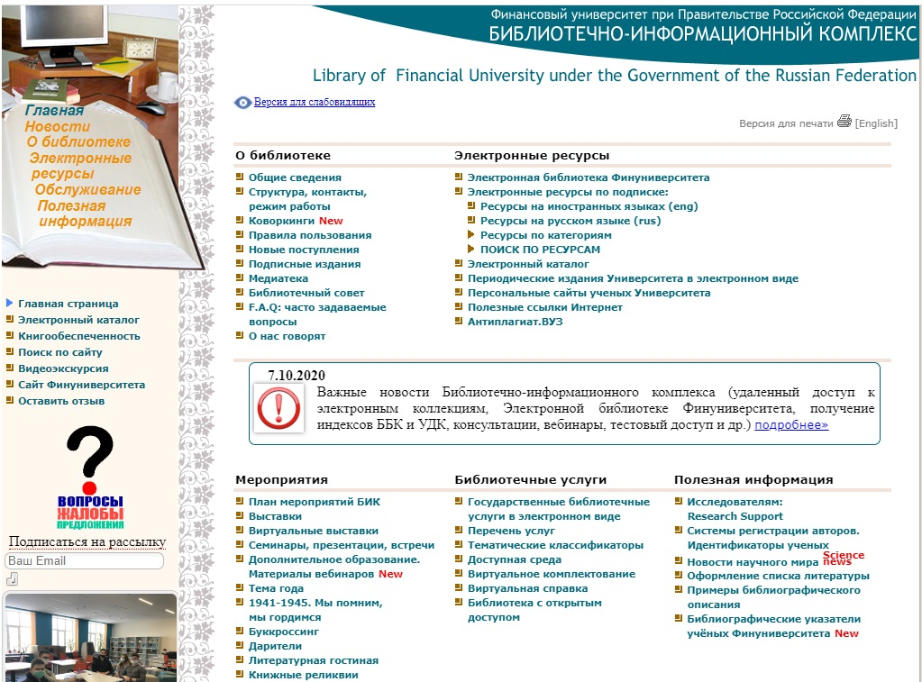
Library and Information Center
One of the biggest collection of financial and economic literature
  Printed as well as digital resources and databases
library.fa.ru

Slide 3
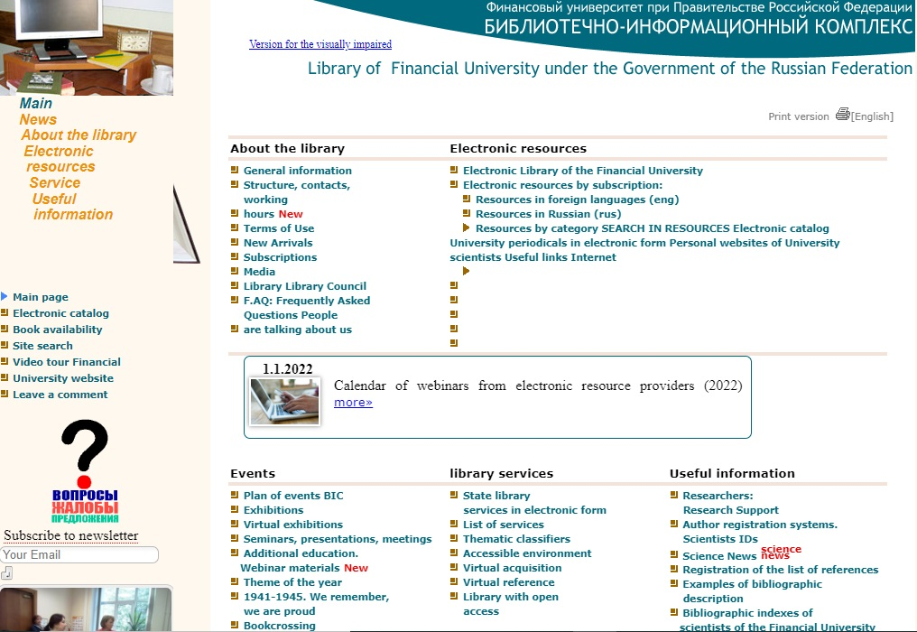
Library and Information Center
library.fa.ru

Slide 4
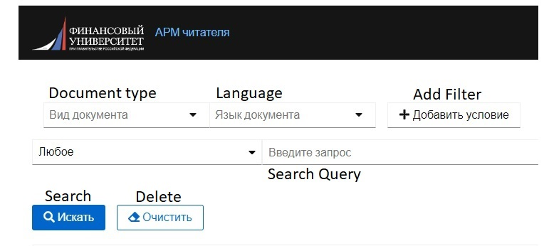
E-Catalogue
You can check the availability of a book in the digital catalogue:
Some books are available as printed copies (can be taken in the library)
Other books can be read online as digital copies
rusneo.fa.ru:8080/pwbo

Slide 5
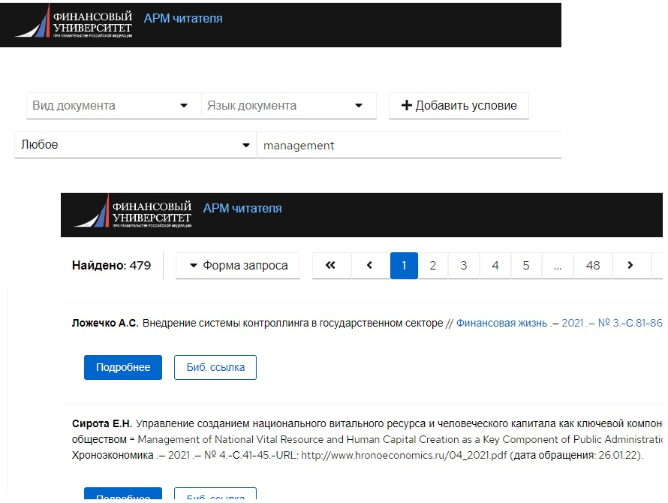
E-Catalogue
rusneo.fa.ru:8080/pwbo

Slide 6
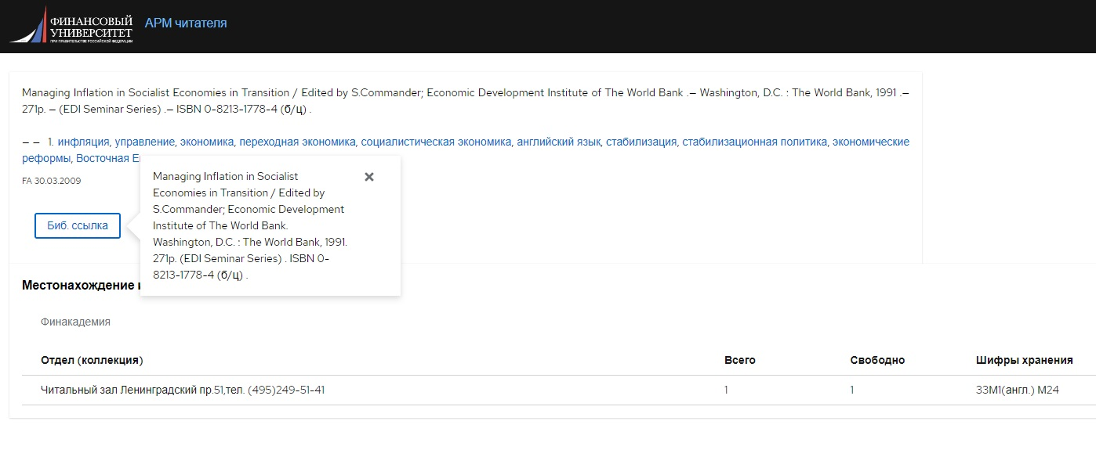
E-Catalogue
rusneo.fa.ru:8080/pwbo

Slide 7
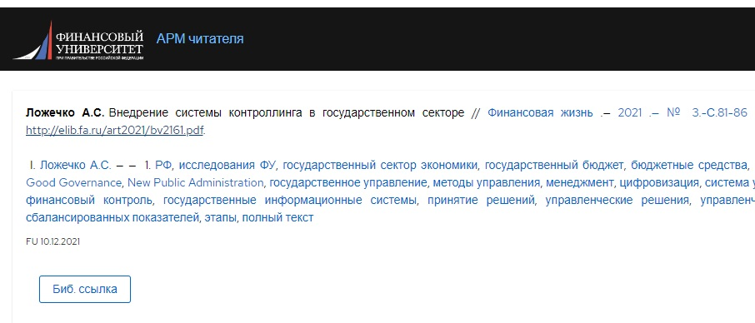
E-Catalogue
rusneo.fa.ru:8080/pwbo

Slide 8
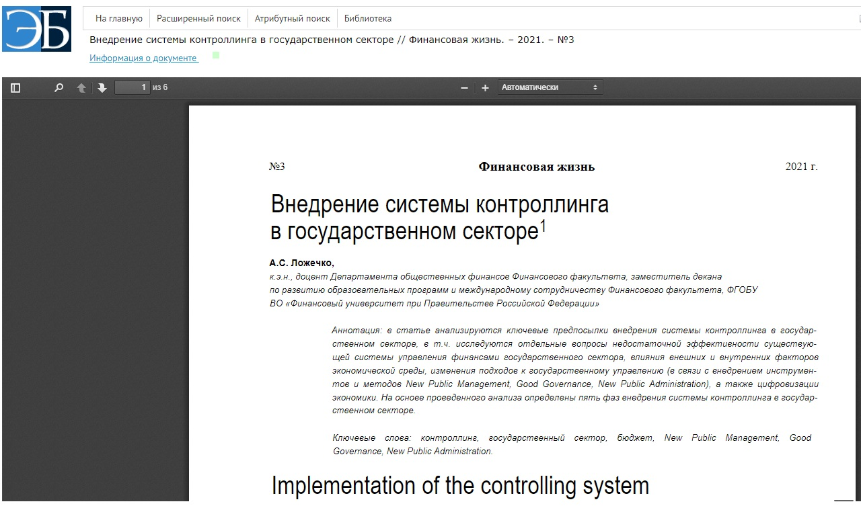
E-Catalogue
rusneo.fa.ru:8080/pwbo

Slide 9
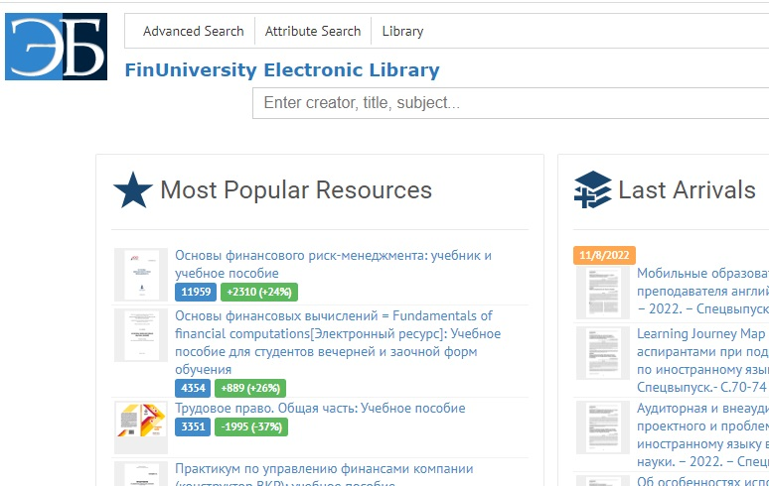
University Digital Library
search box
One of the biggest collection of financial and economic literature
  Printed and digital resources and databases
elib.fa.ru

Slide 10
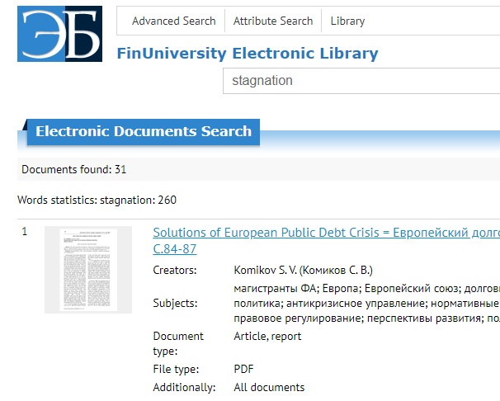
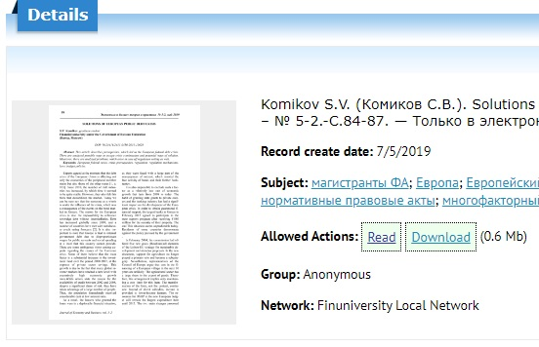
University Digital Library
search query
elib.fa.ru

Slide 11
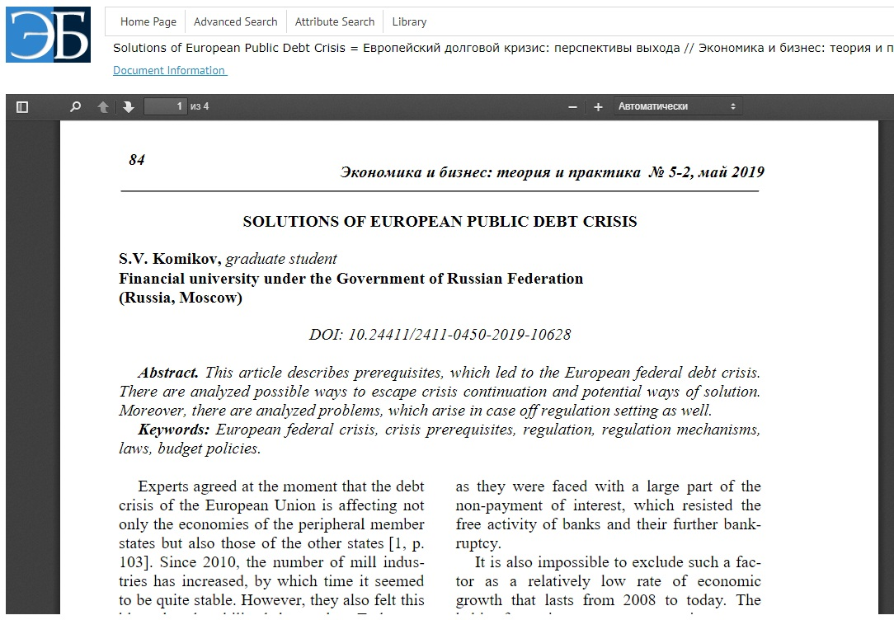
University Digital Library
elib.fa.ru

Slide 12
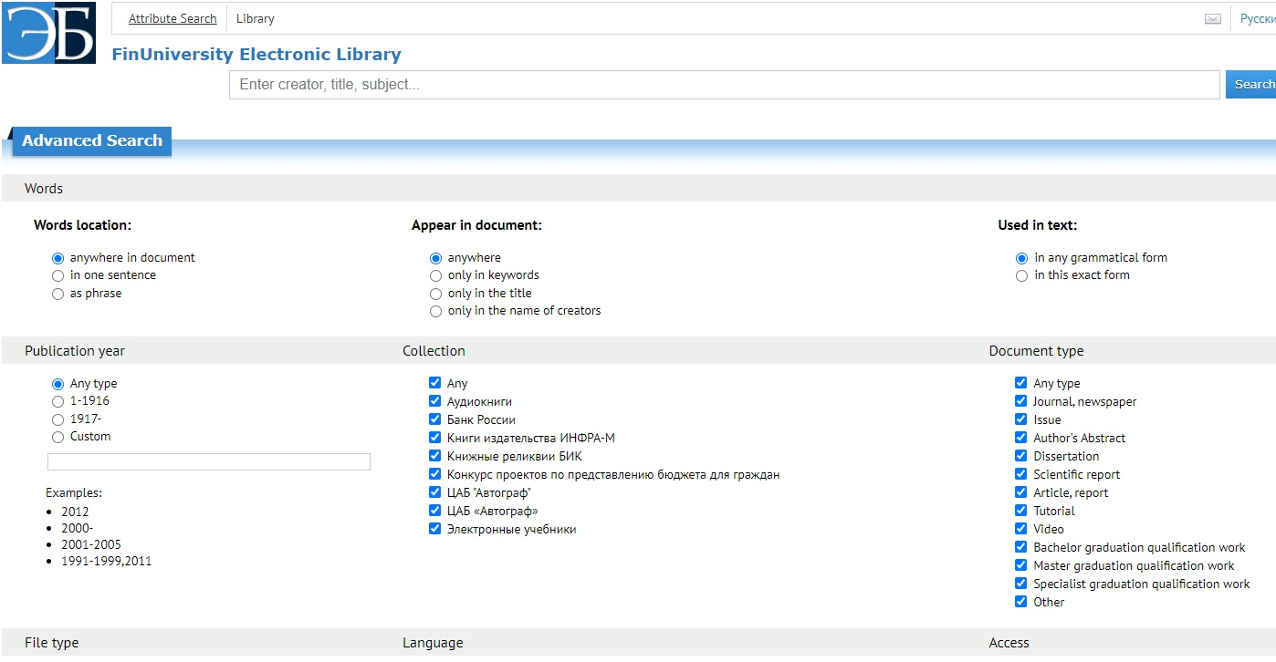
University Digital Library
elib.fa.ru

Slide 13
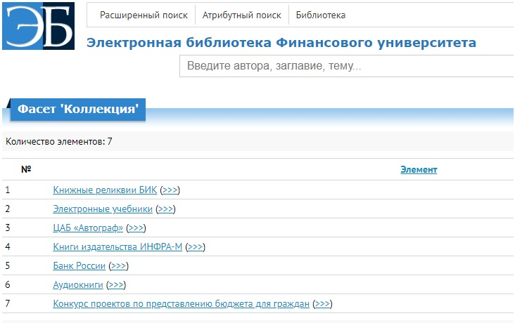
University Digital Library
Collections available in the E-Library of the university
http://elib.fa.ru/facets/Kollekciya?sort=4

Slide 14
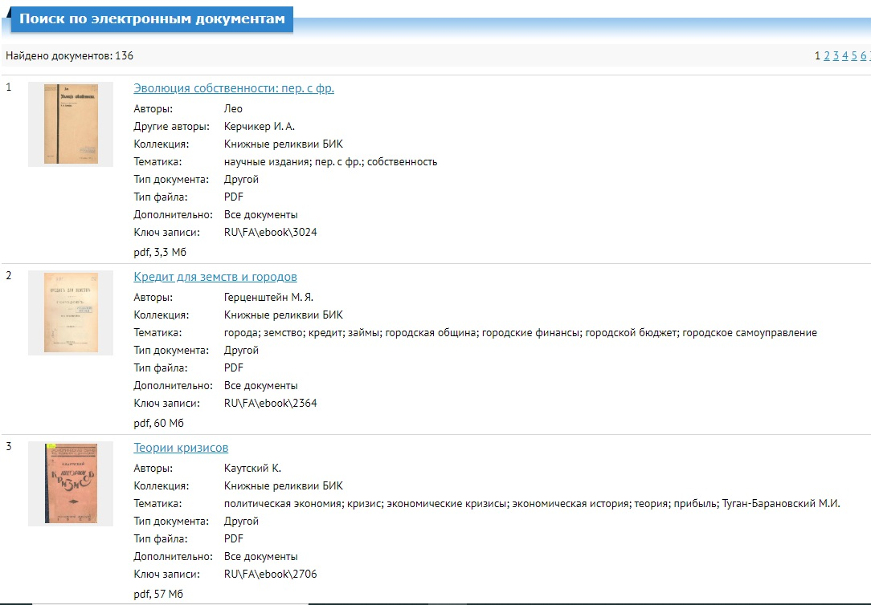
University Digital Library
http://elib.fa.ru/facets/Kollekciya?sort=4

Slide 15


University Digital Library and Catalogue
There is a difference between the E-Library and E-Catalogue of the university. The catalogue contains the information about all the books and articles printed and digital ones, which are available in the library.

Slide 16

External Digital Data
Full-text scientific magazines, books, articles in Russian and English.
Economic, financial and legal databases.
Information about patents.
Links to other free access network resources.

Slide 17
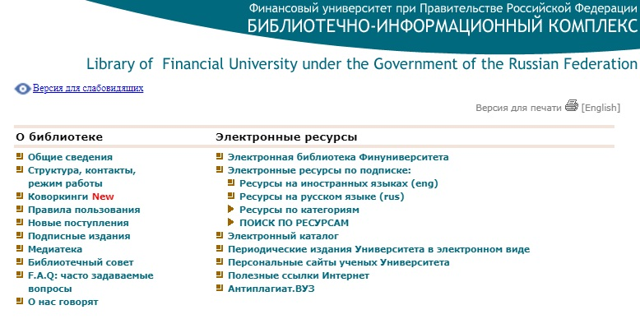
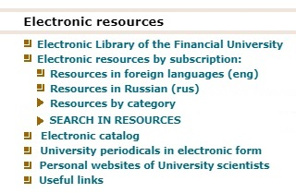
External Digital Data
library.fa.ru

Slide 18
External Digital Data
library.fa.ru

Slide 19
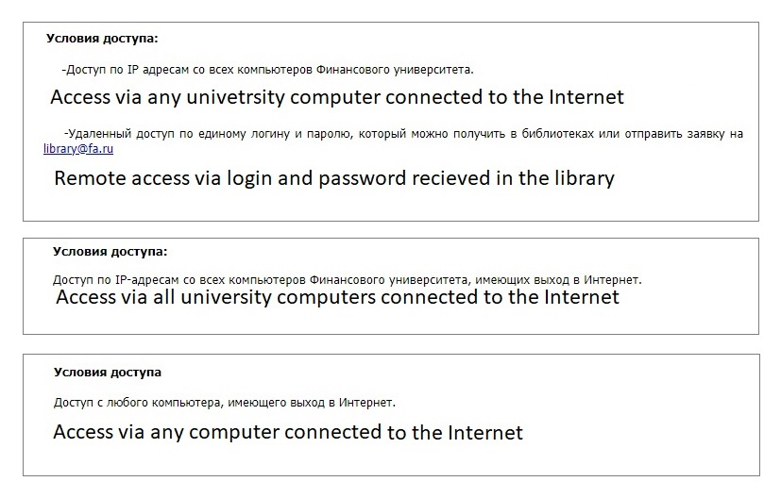
Access conditions
All the information is available on the webiste of the library

Slide 20
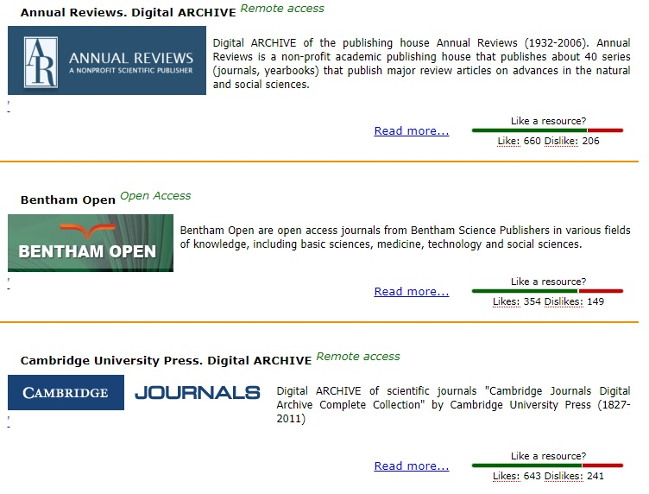
External Digital Data

Slide 21
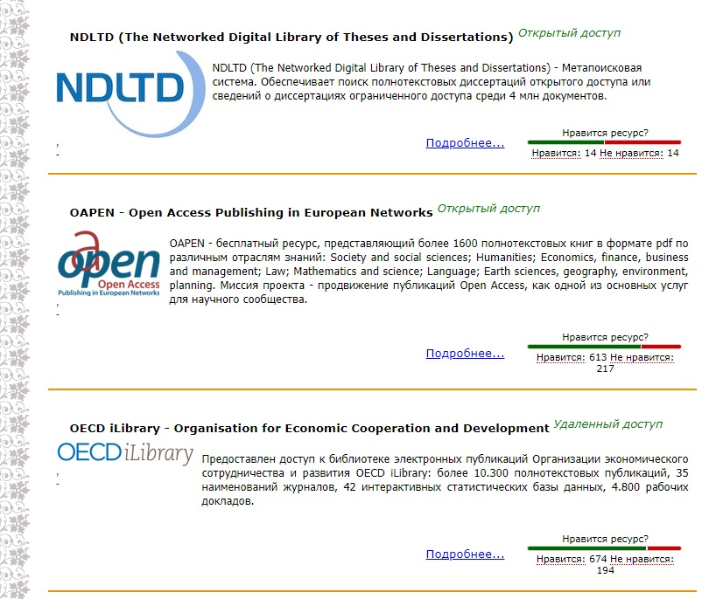
External Digital Data

Slide 22
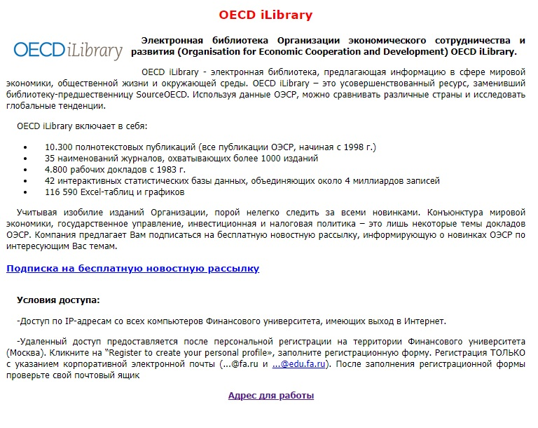
External Digital Data

Slide 23
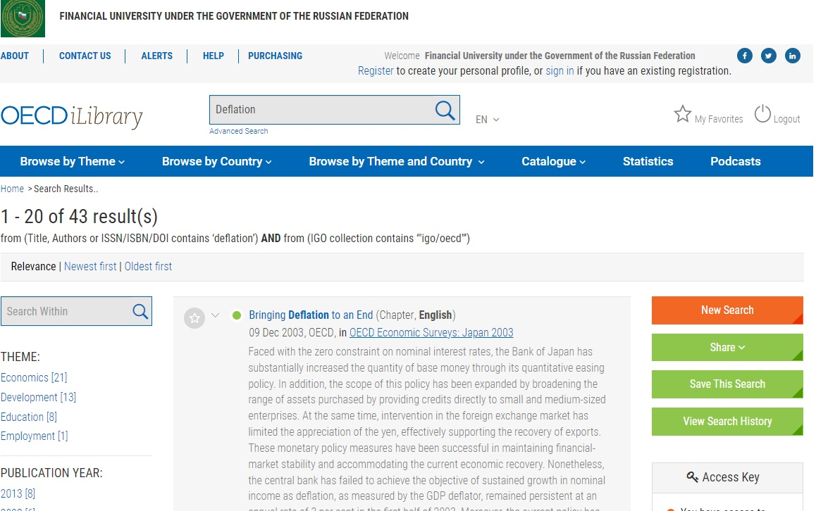
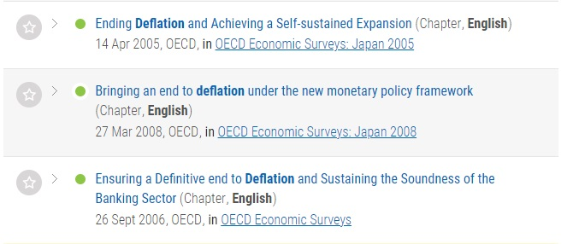
External Digital Data

Slide 24
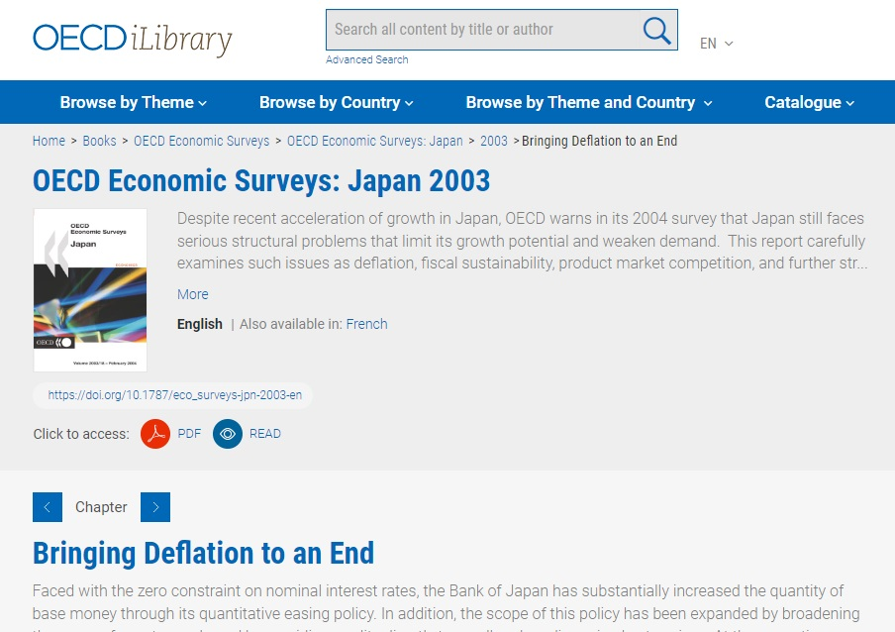
External Digital Data

Slide 25
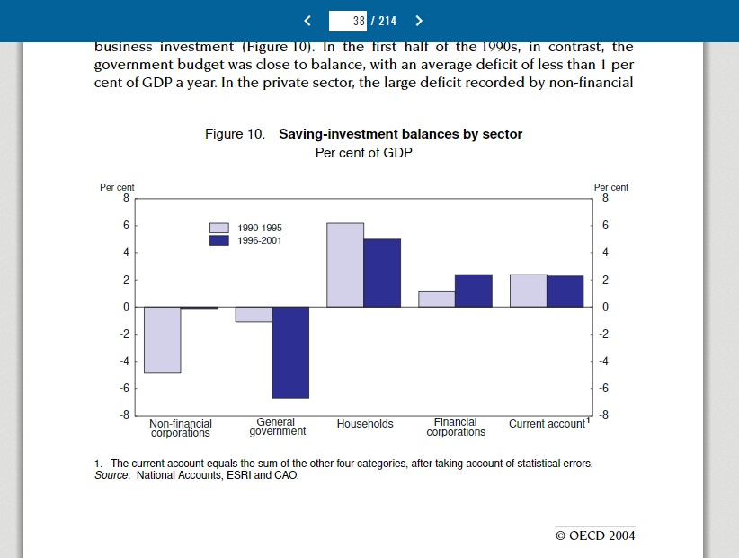
External Digital Data

Slide 26
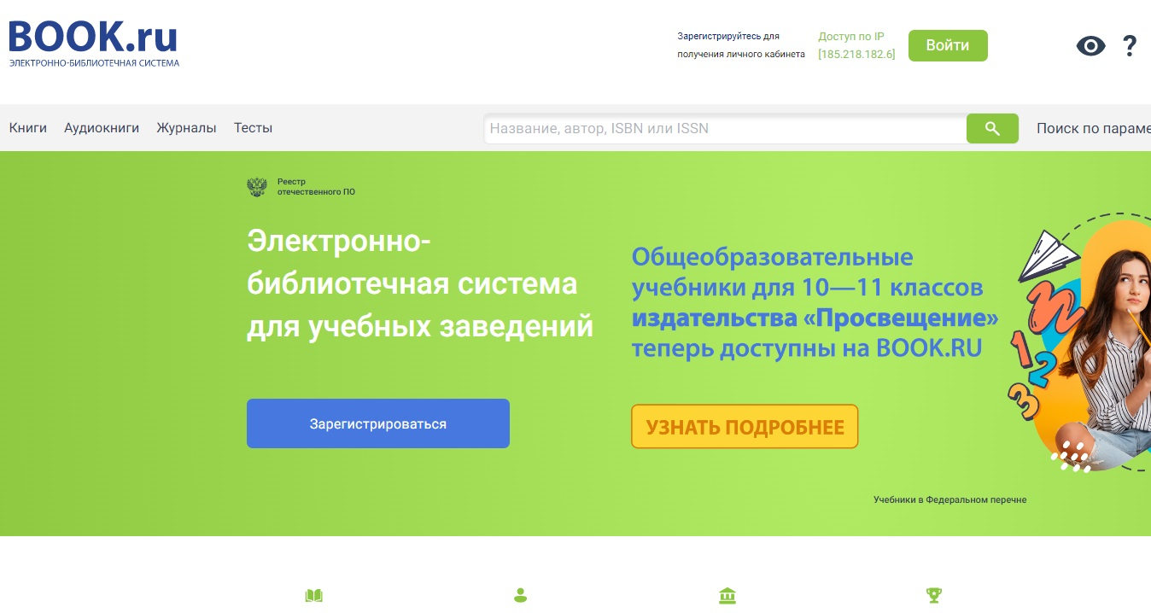
External Digital Data

Slide 27
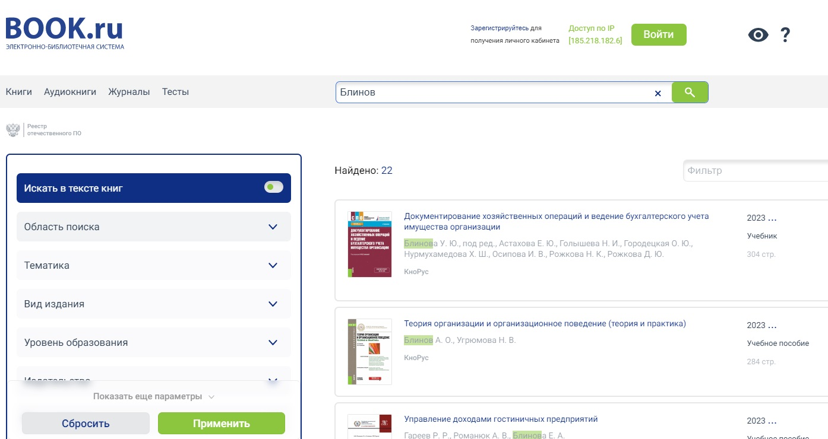
External Digital Data

Slide 28
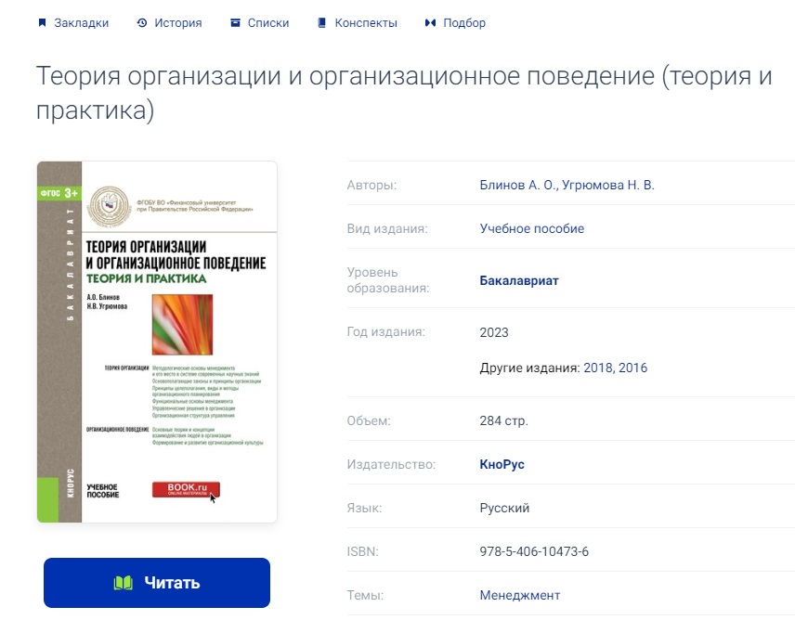
External Digital Data

Slide 29
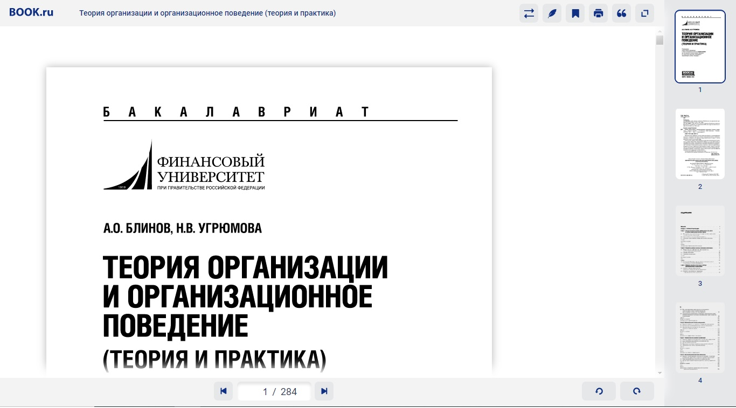
External Digital Data
Add the book to your personal list
Make a bookmark
Make a reference
Print
Get the bibliographic information

Slide 30
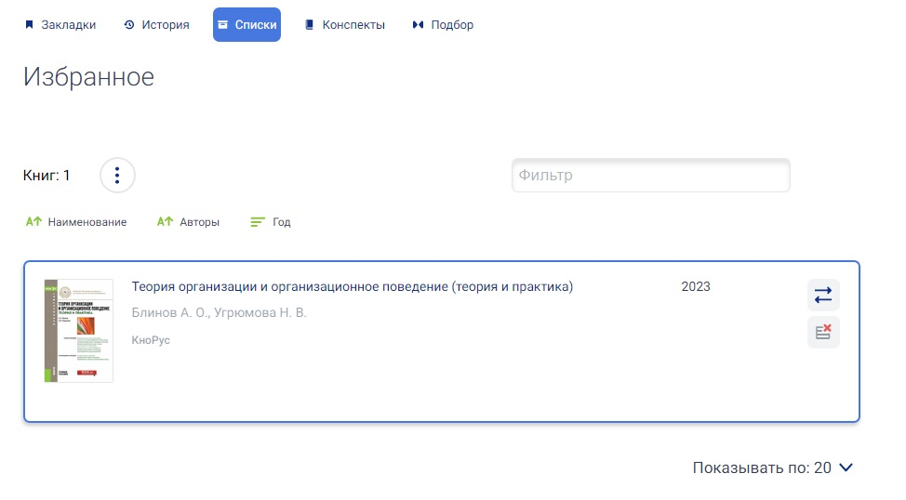
External Digital Data

Slide 31
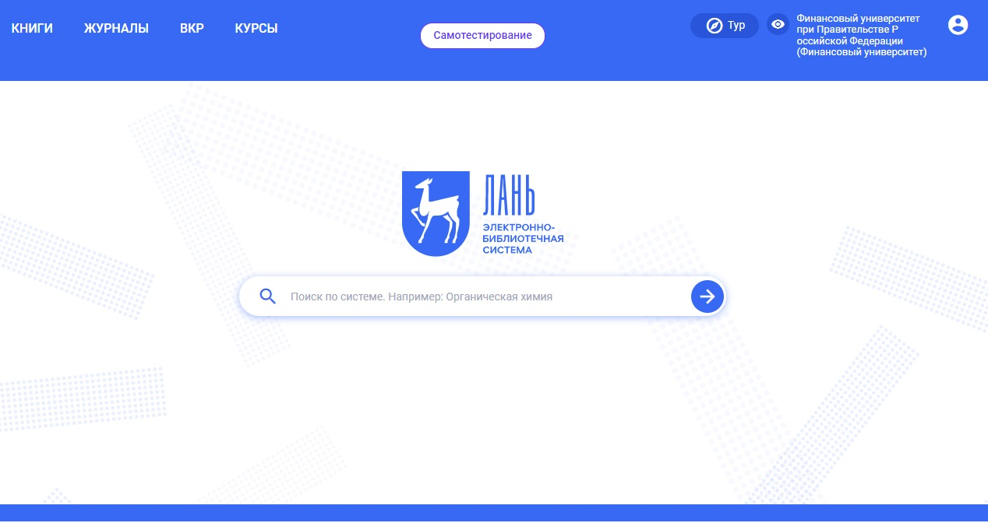
External Digital Data

Slide 32
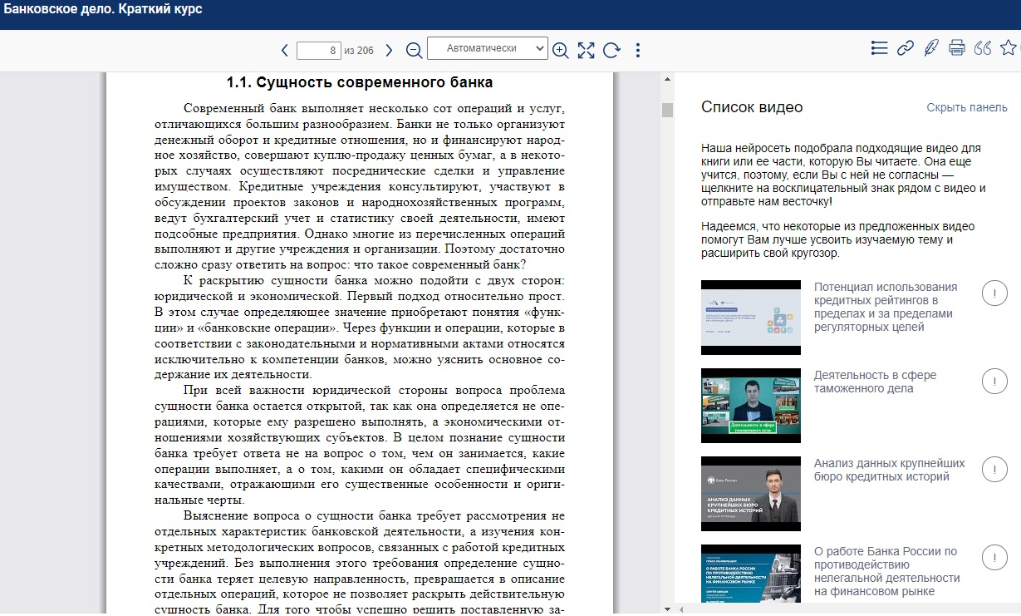
External Digital Data

Slide 33
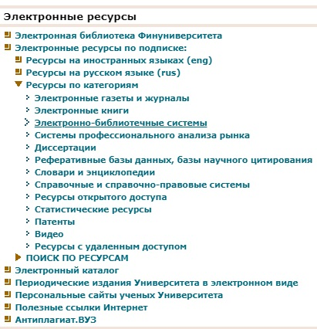
External Digital Data

Slide 34
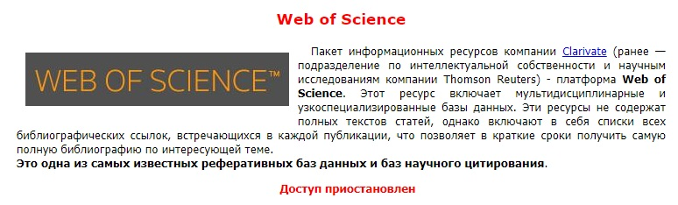
Temporally unavailable Websites
Remote access to databases through EZ-proxy has been terminated.
(This includes access through the portal https://org.fa.ru).
Please note that all databases under the Financial Reward subscription are accessible by IP addresses (Moscow).

Slide 35
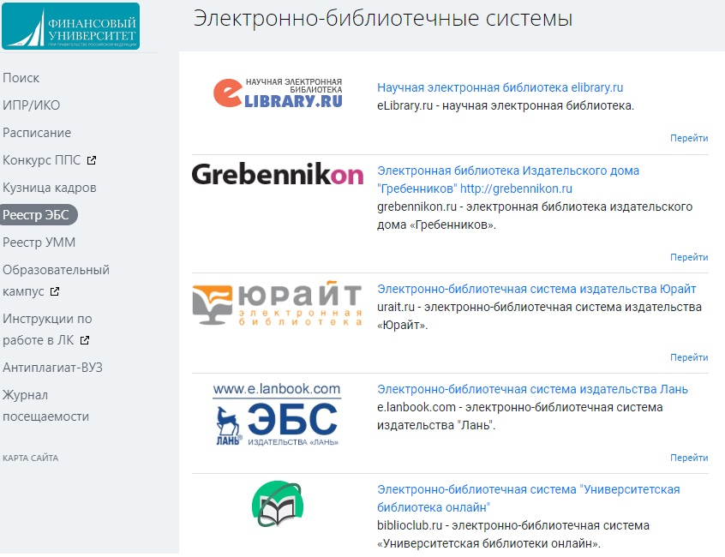
External Digital Data
org.fa.ru/app/ebs/list

Slide 36
Summing up
Internal Resources:
E-Library
Digital books and articles written by the Financial University professors
E-Catalogue
Information about all the books in the library
Access from the library website or org.fa.ru
External Resources:
Russian Databases
Books, articles, student books
Foreign Databases
Articles, scientific books and magazines
Different types of access (Library computer, remote access)

